Slide 1
The Curse of Democracy: Evidence from the 21st Century
Yusuke Narita
Ayumi Sudo

Slide 2
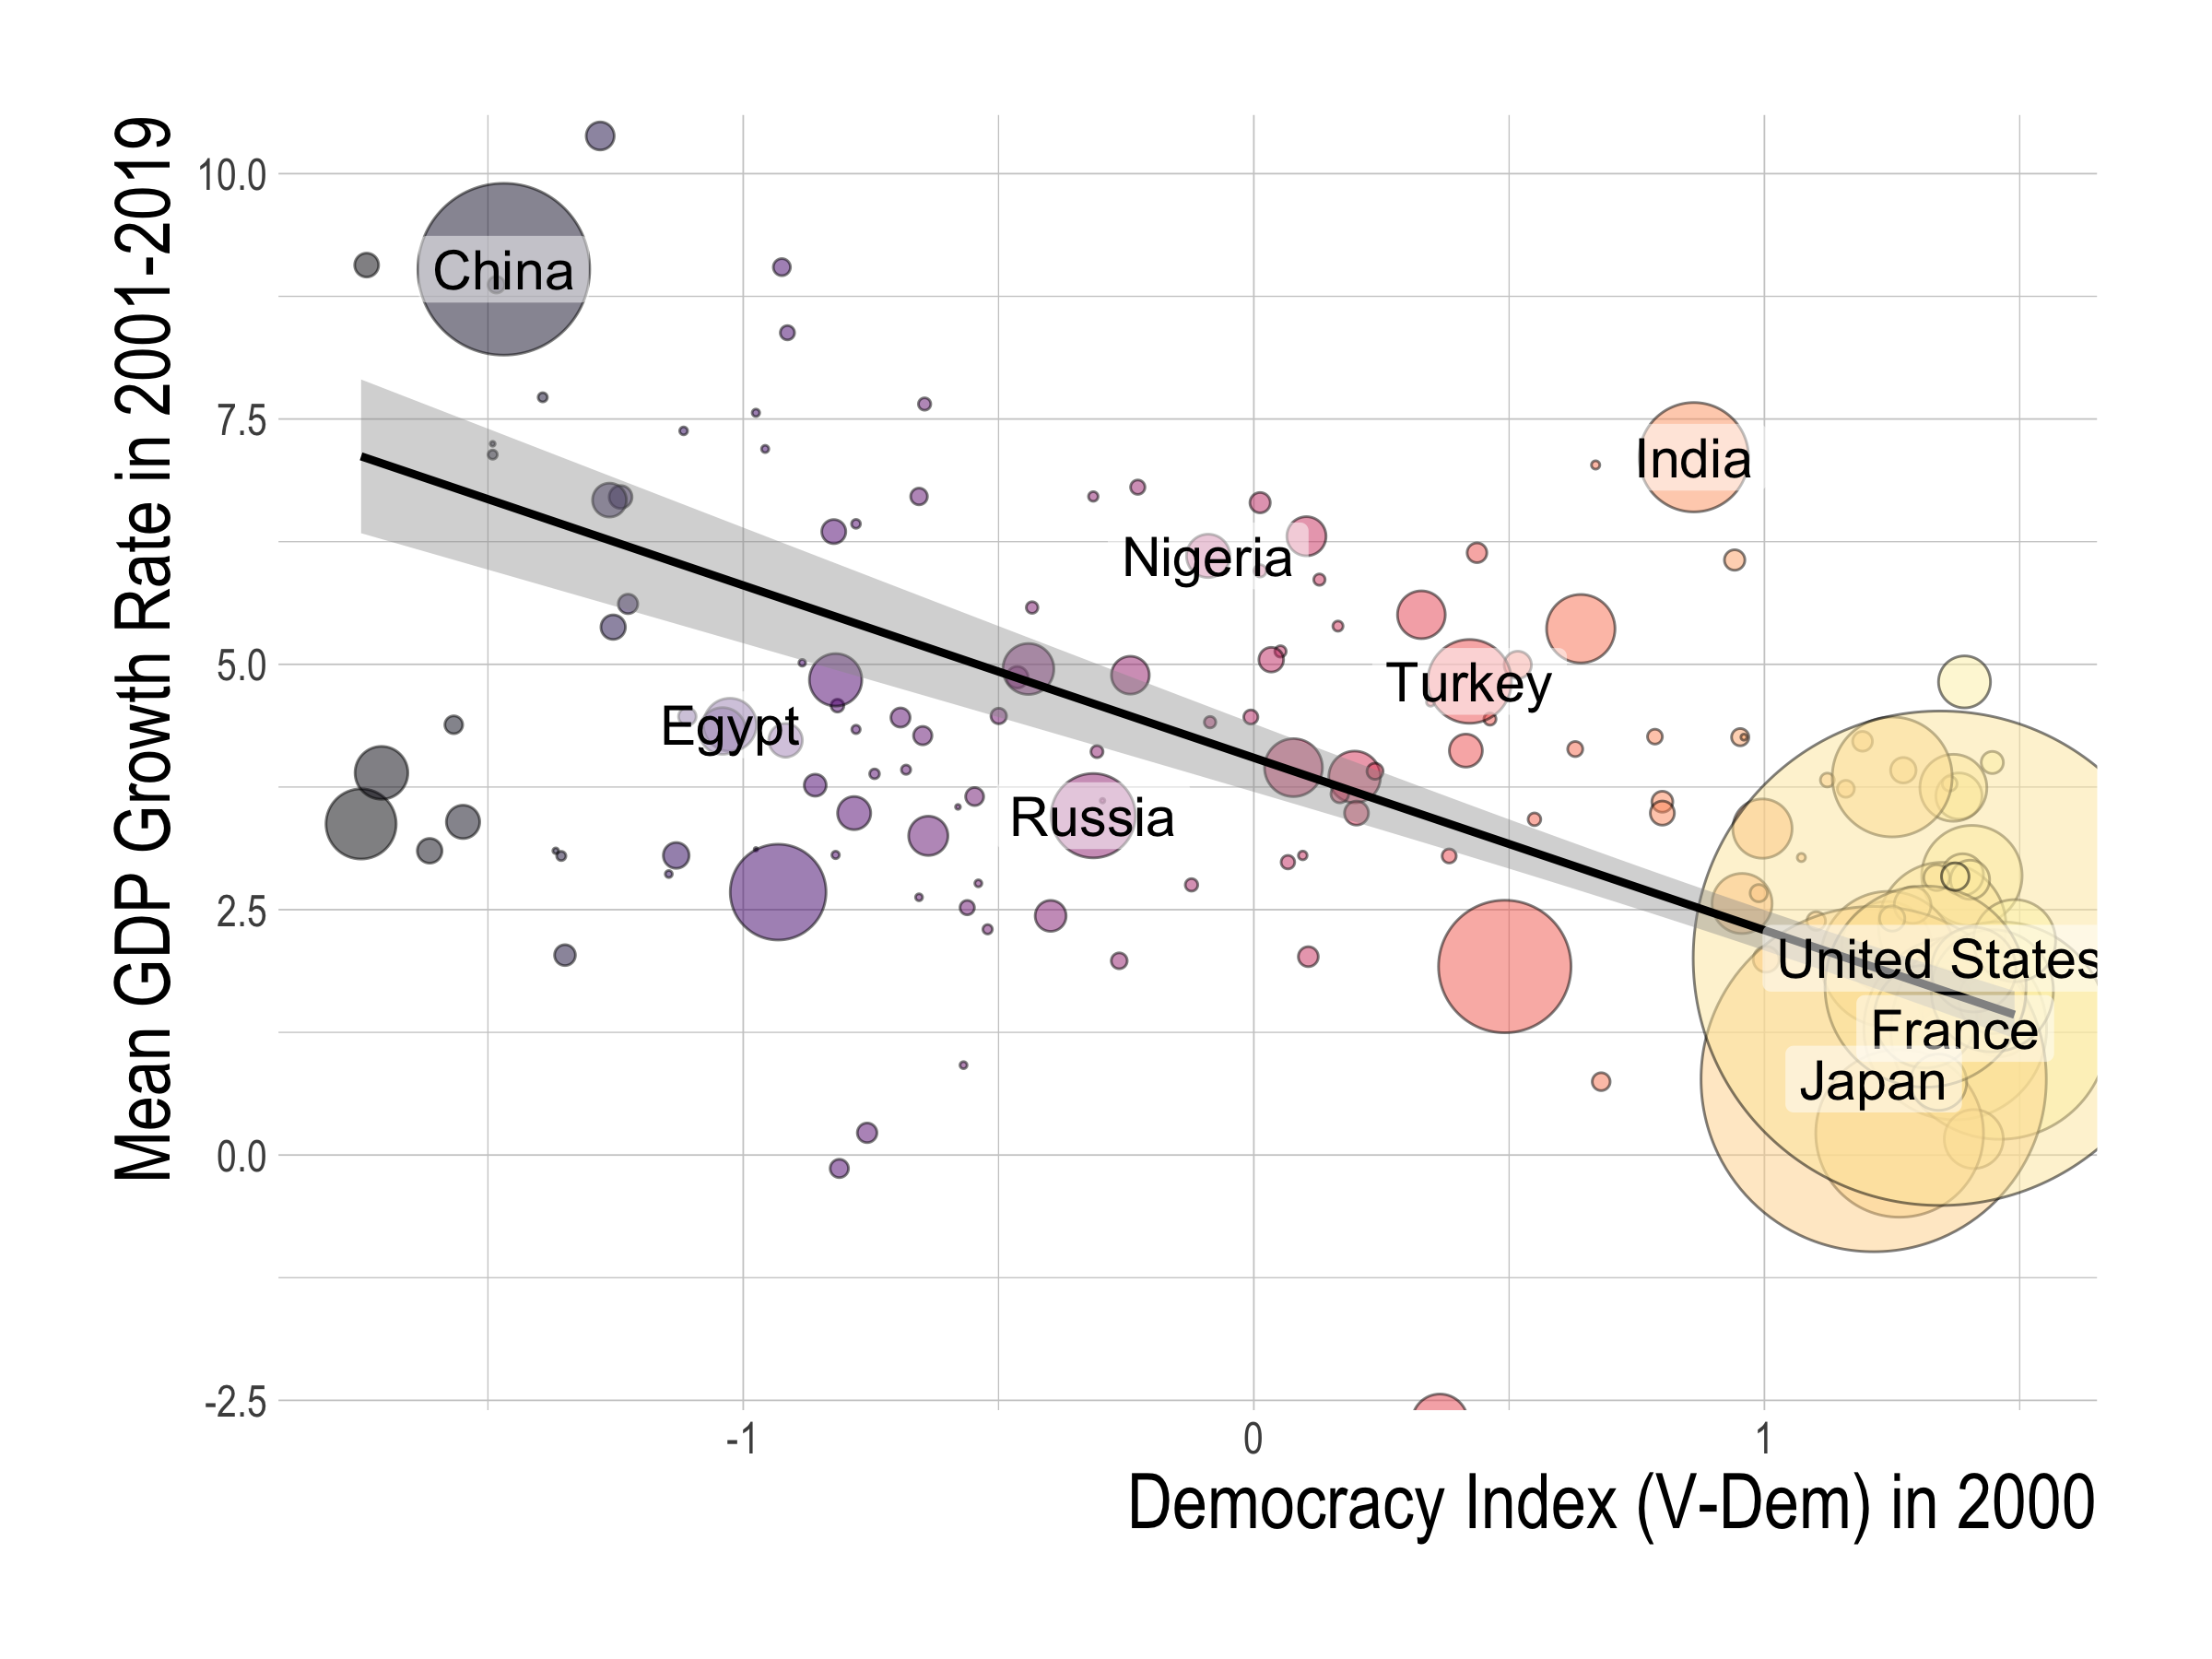

Slide 3
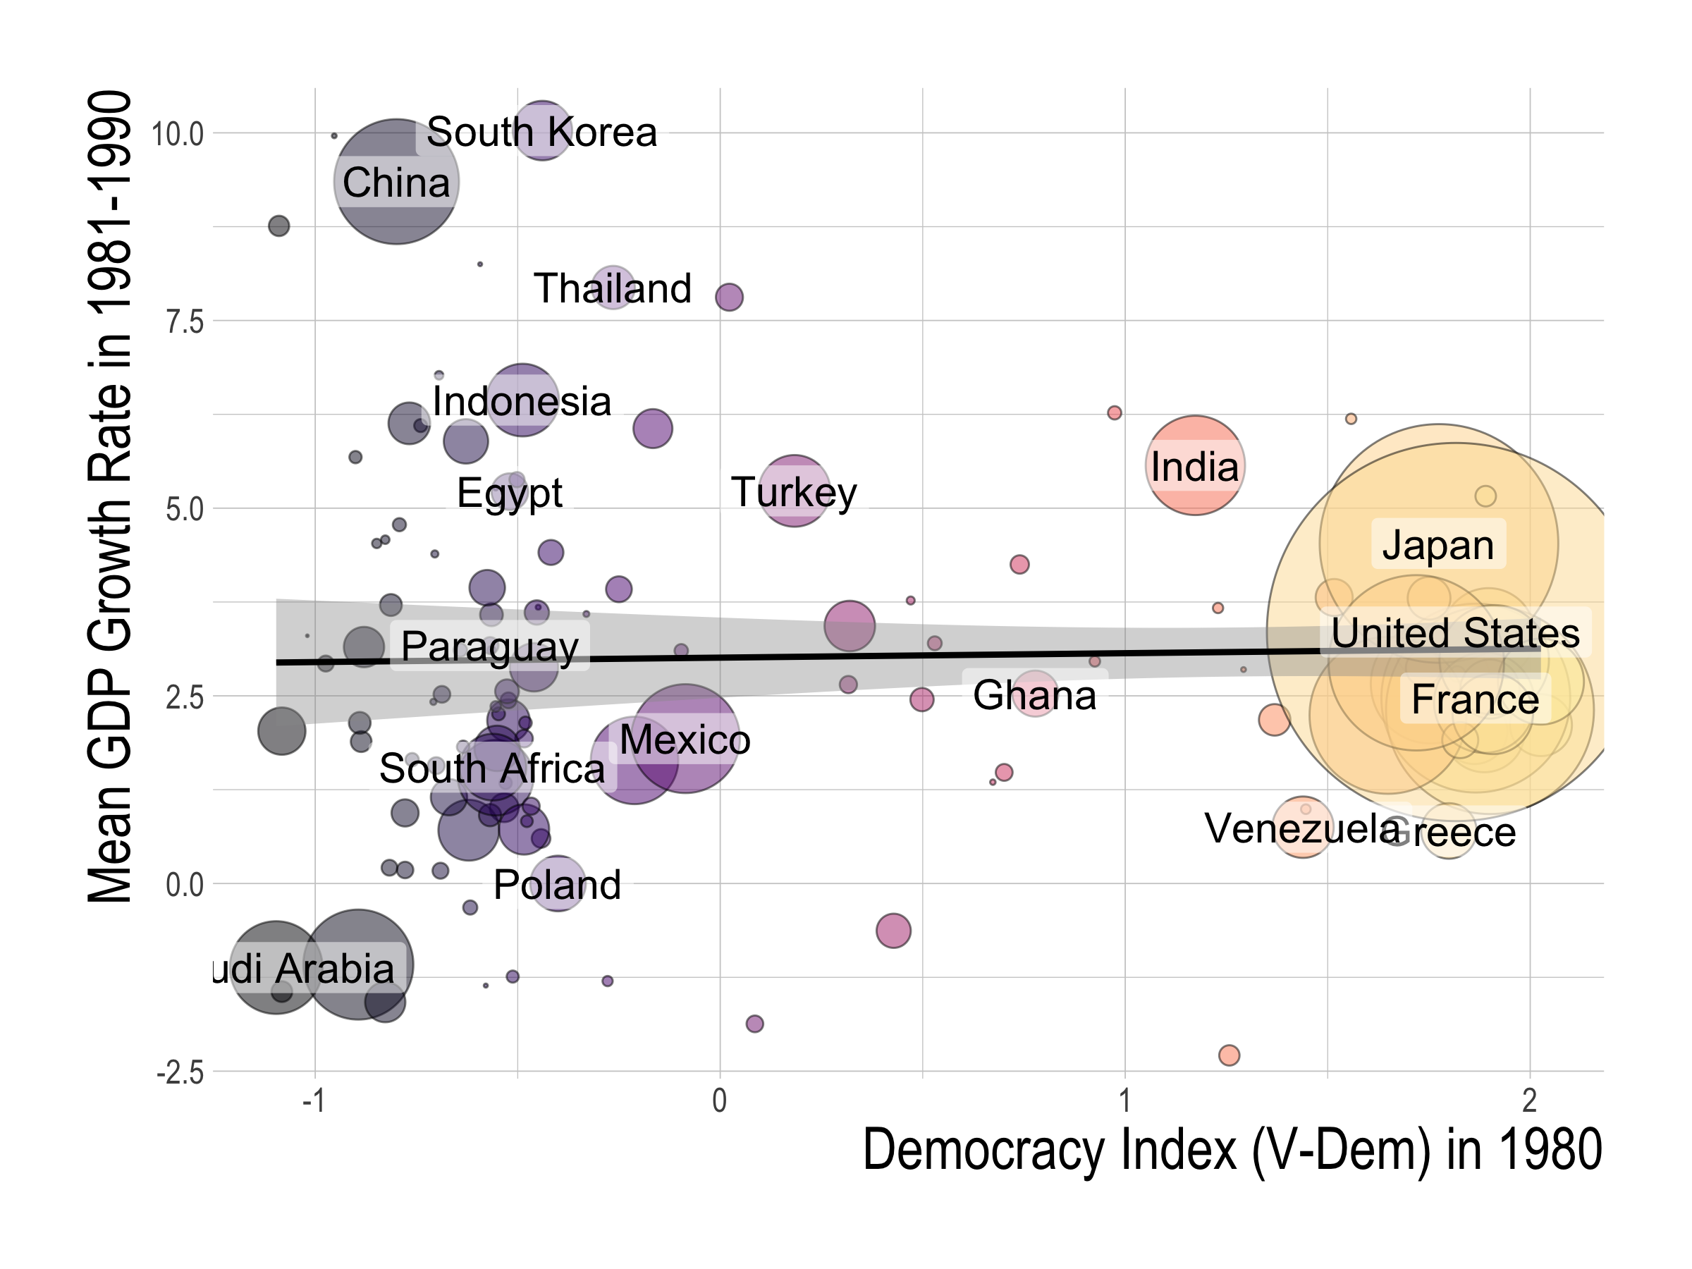
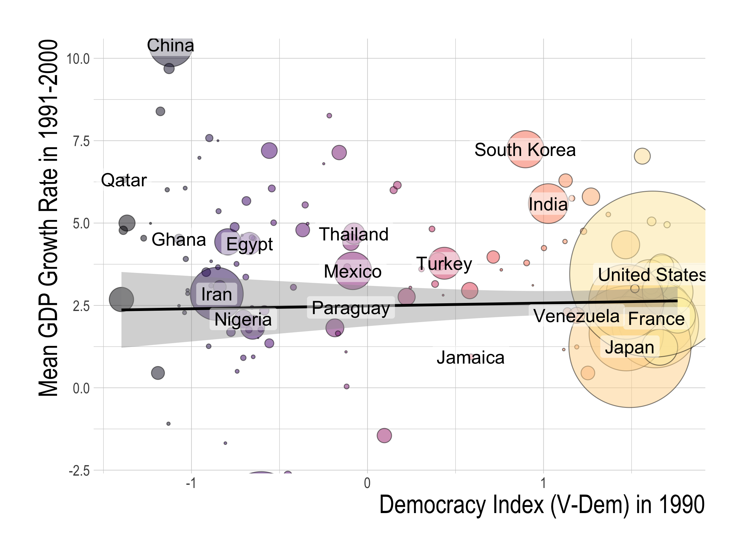
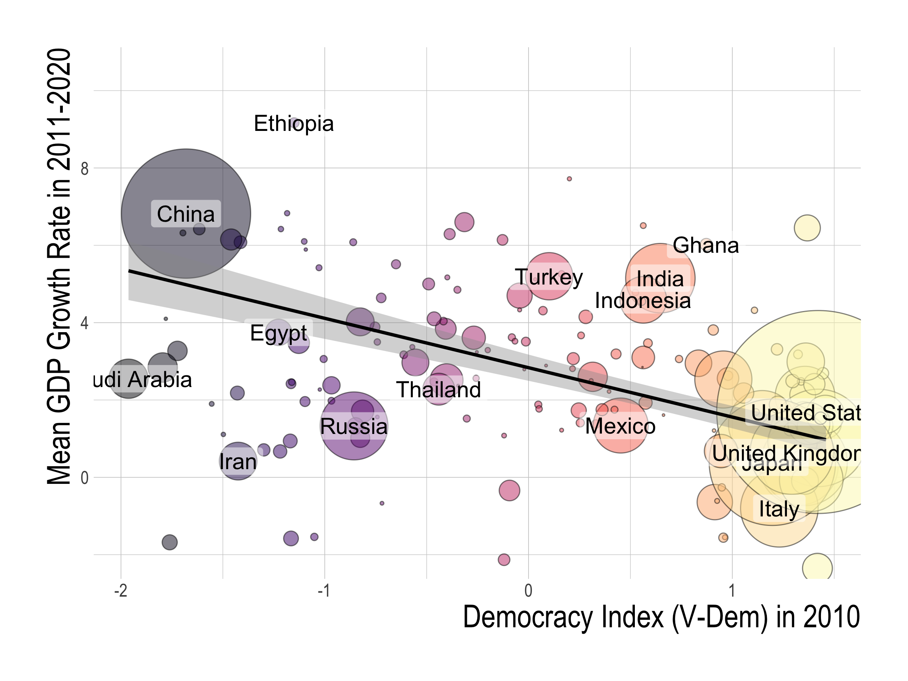
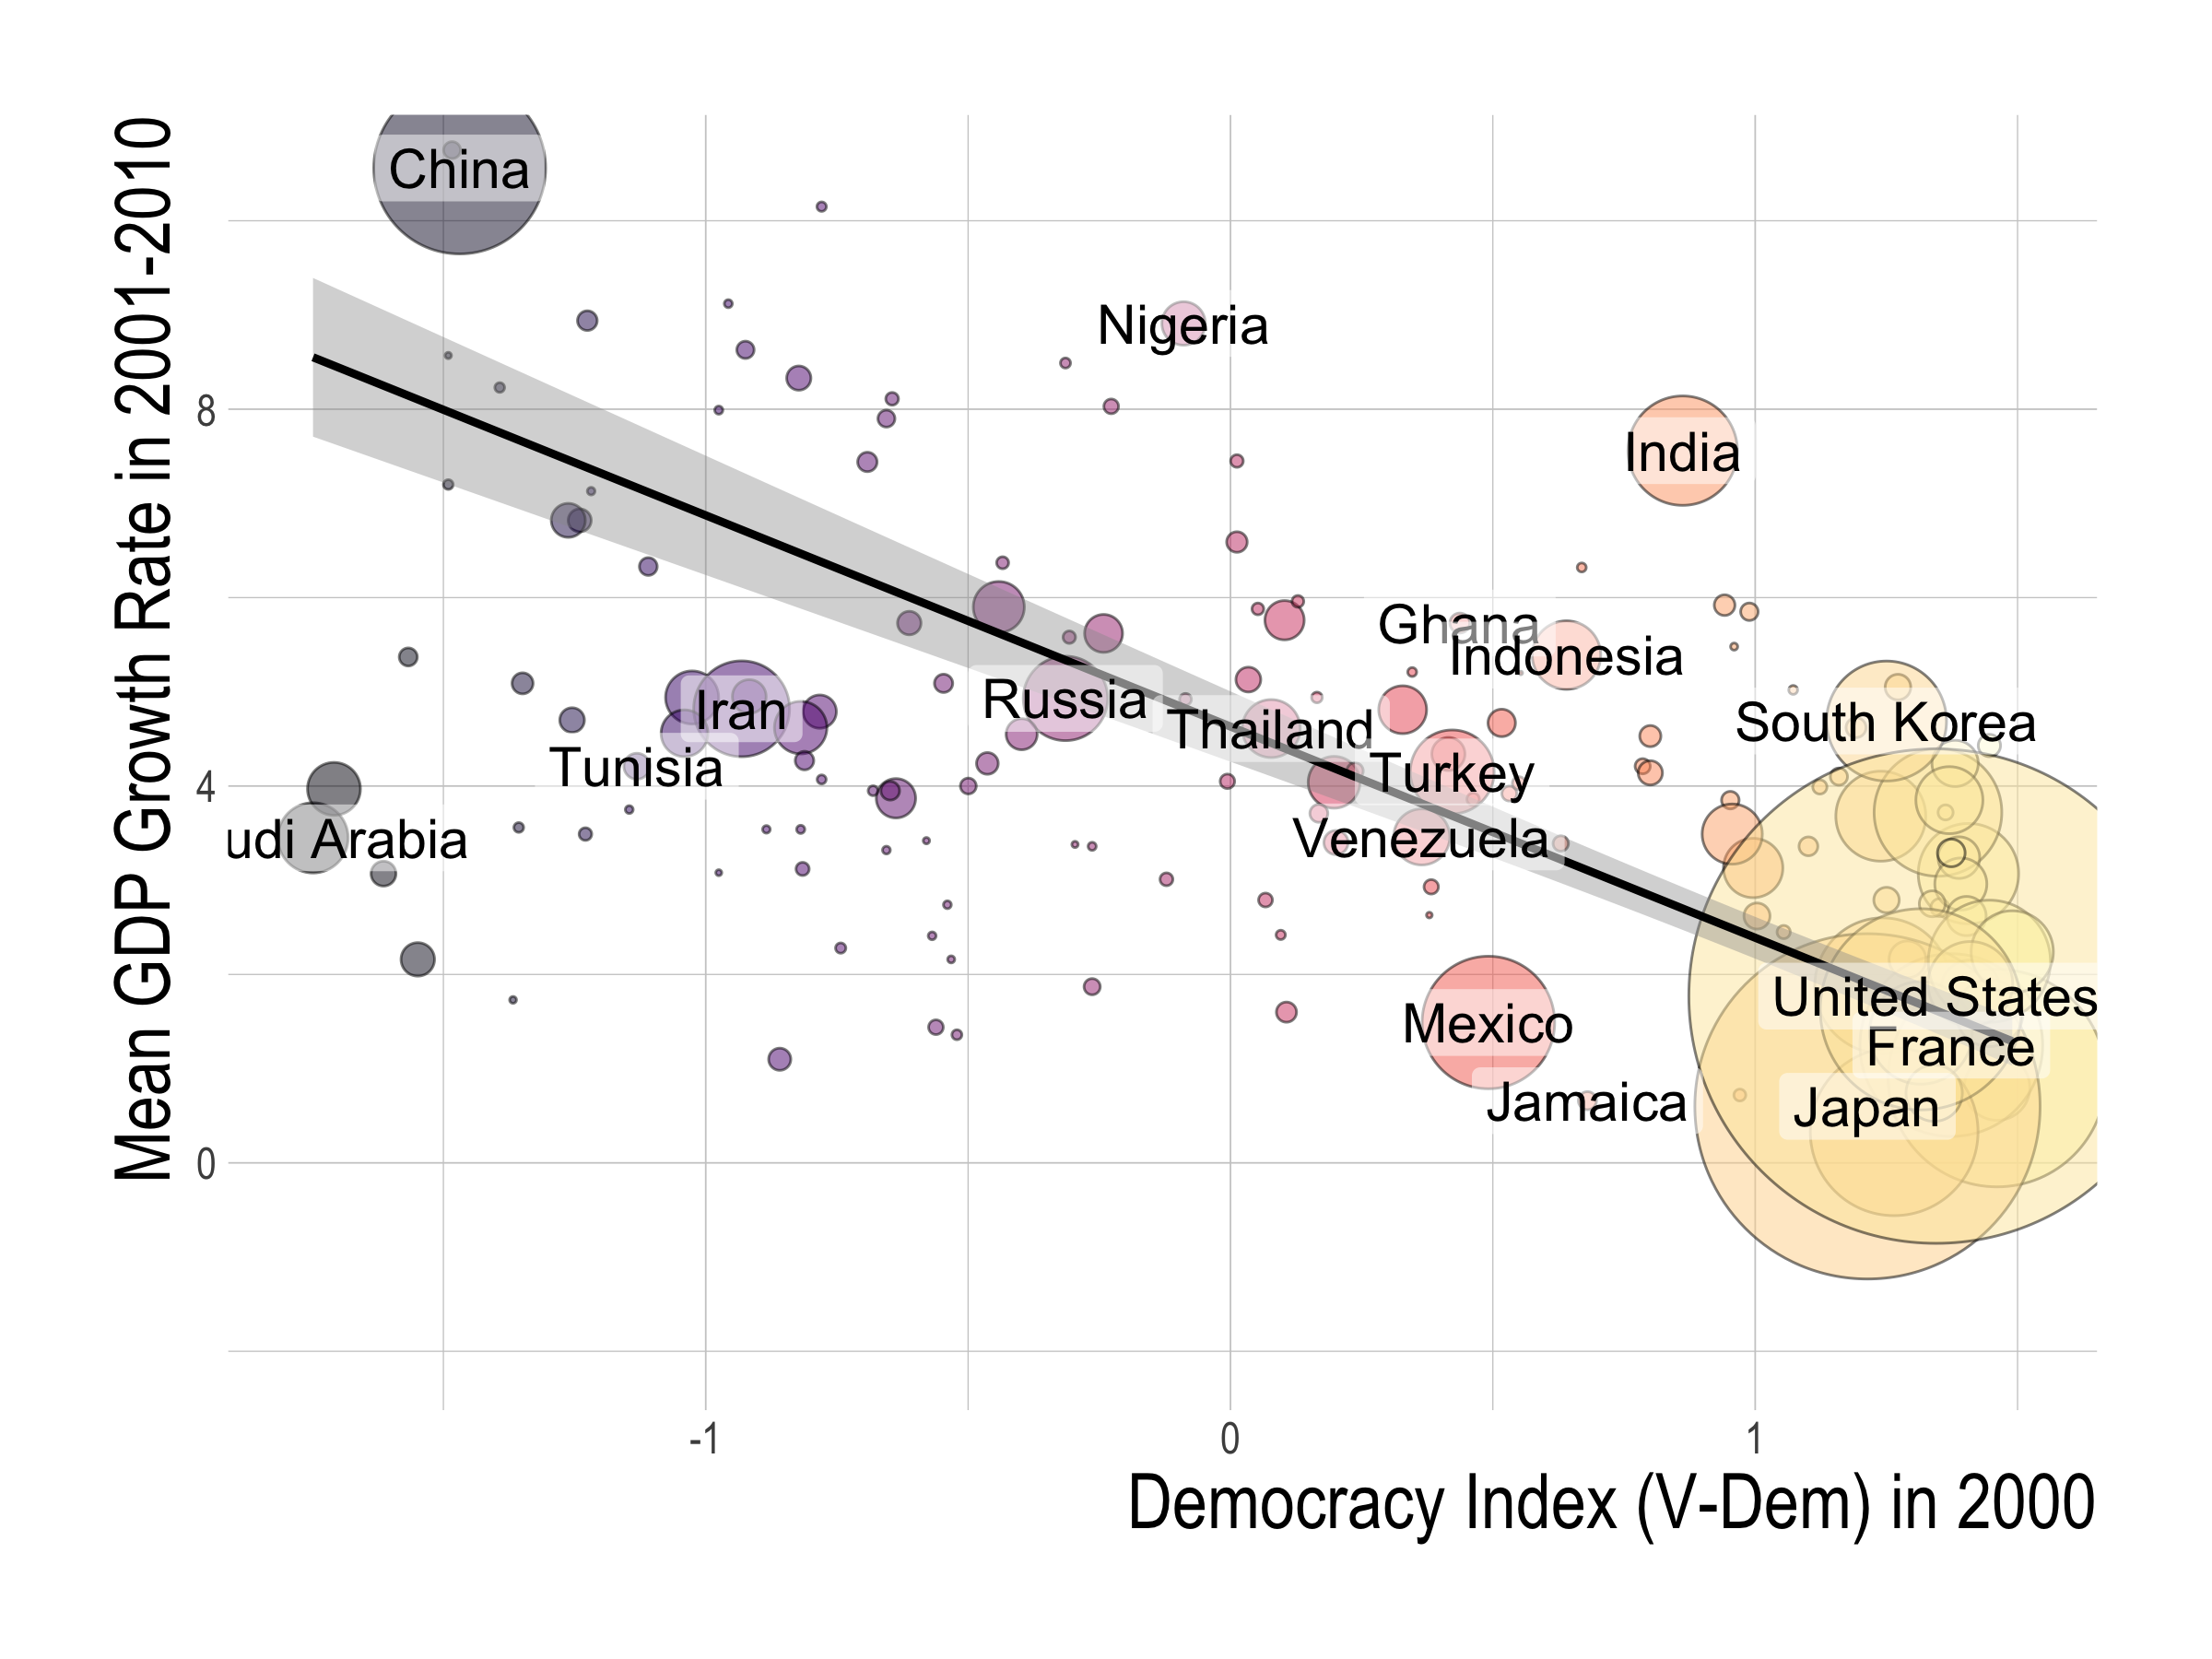

Slide 4
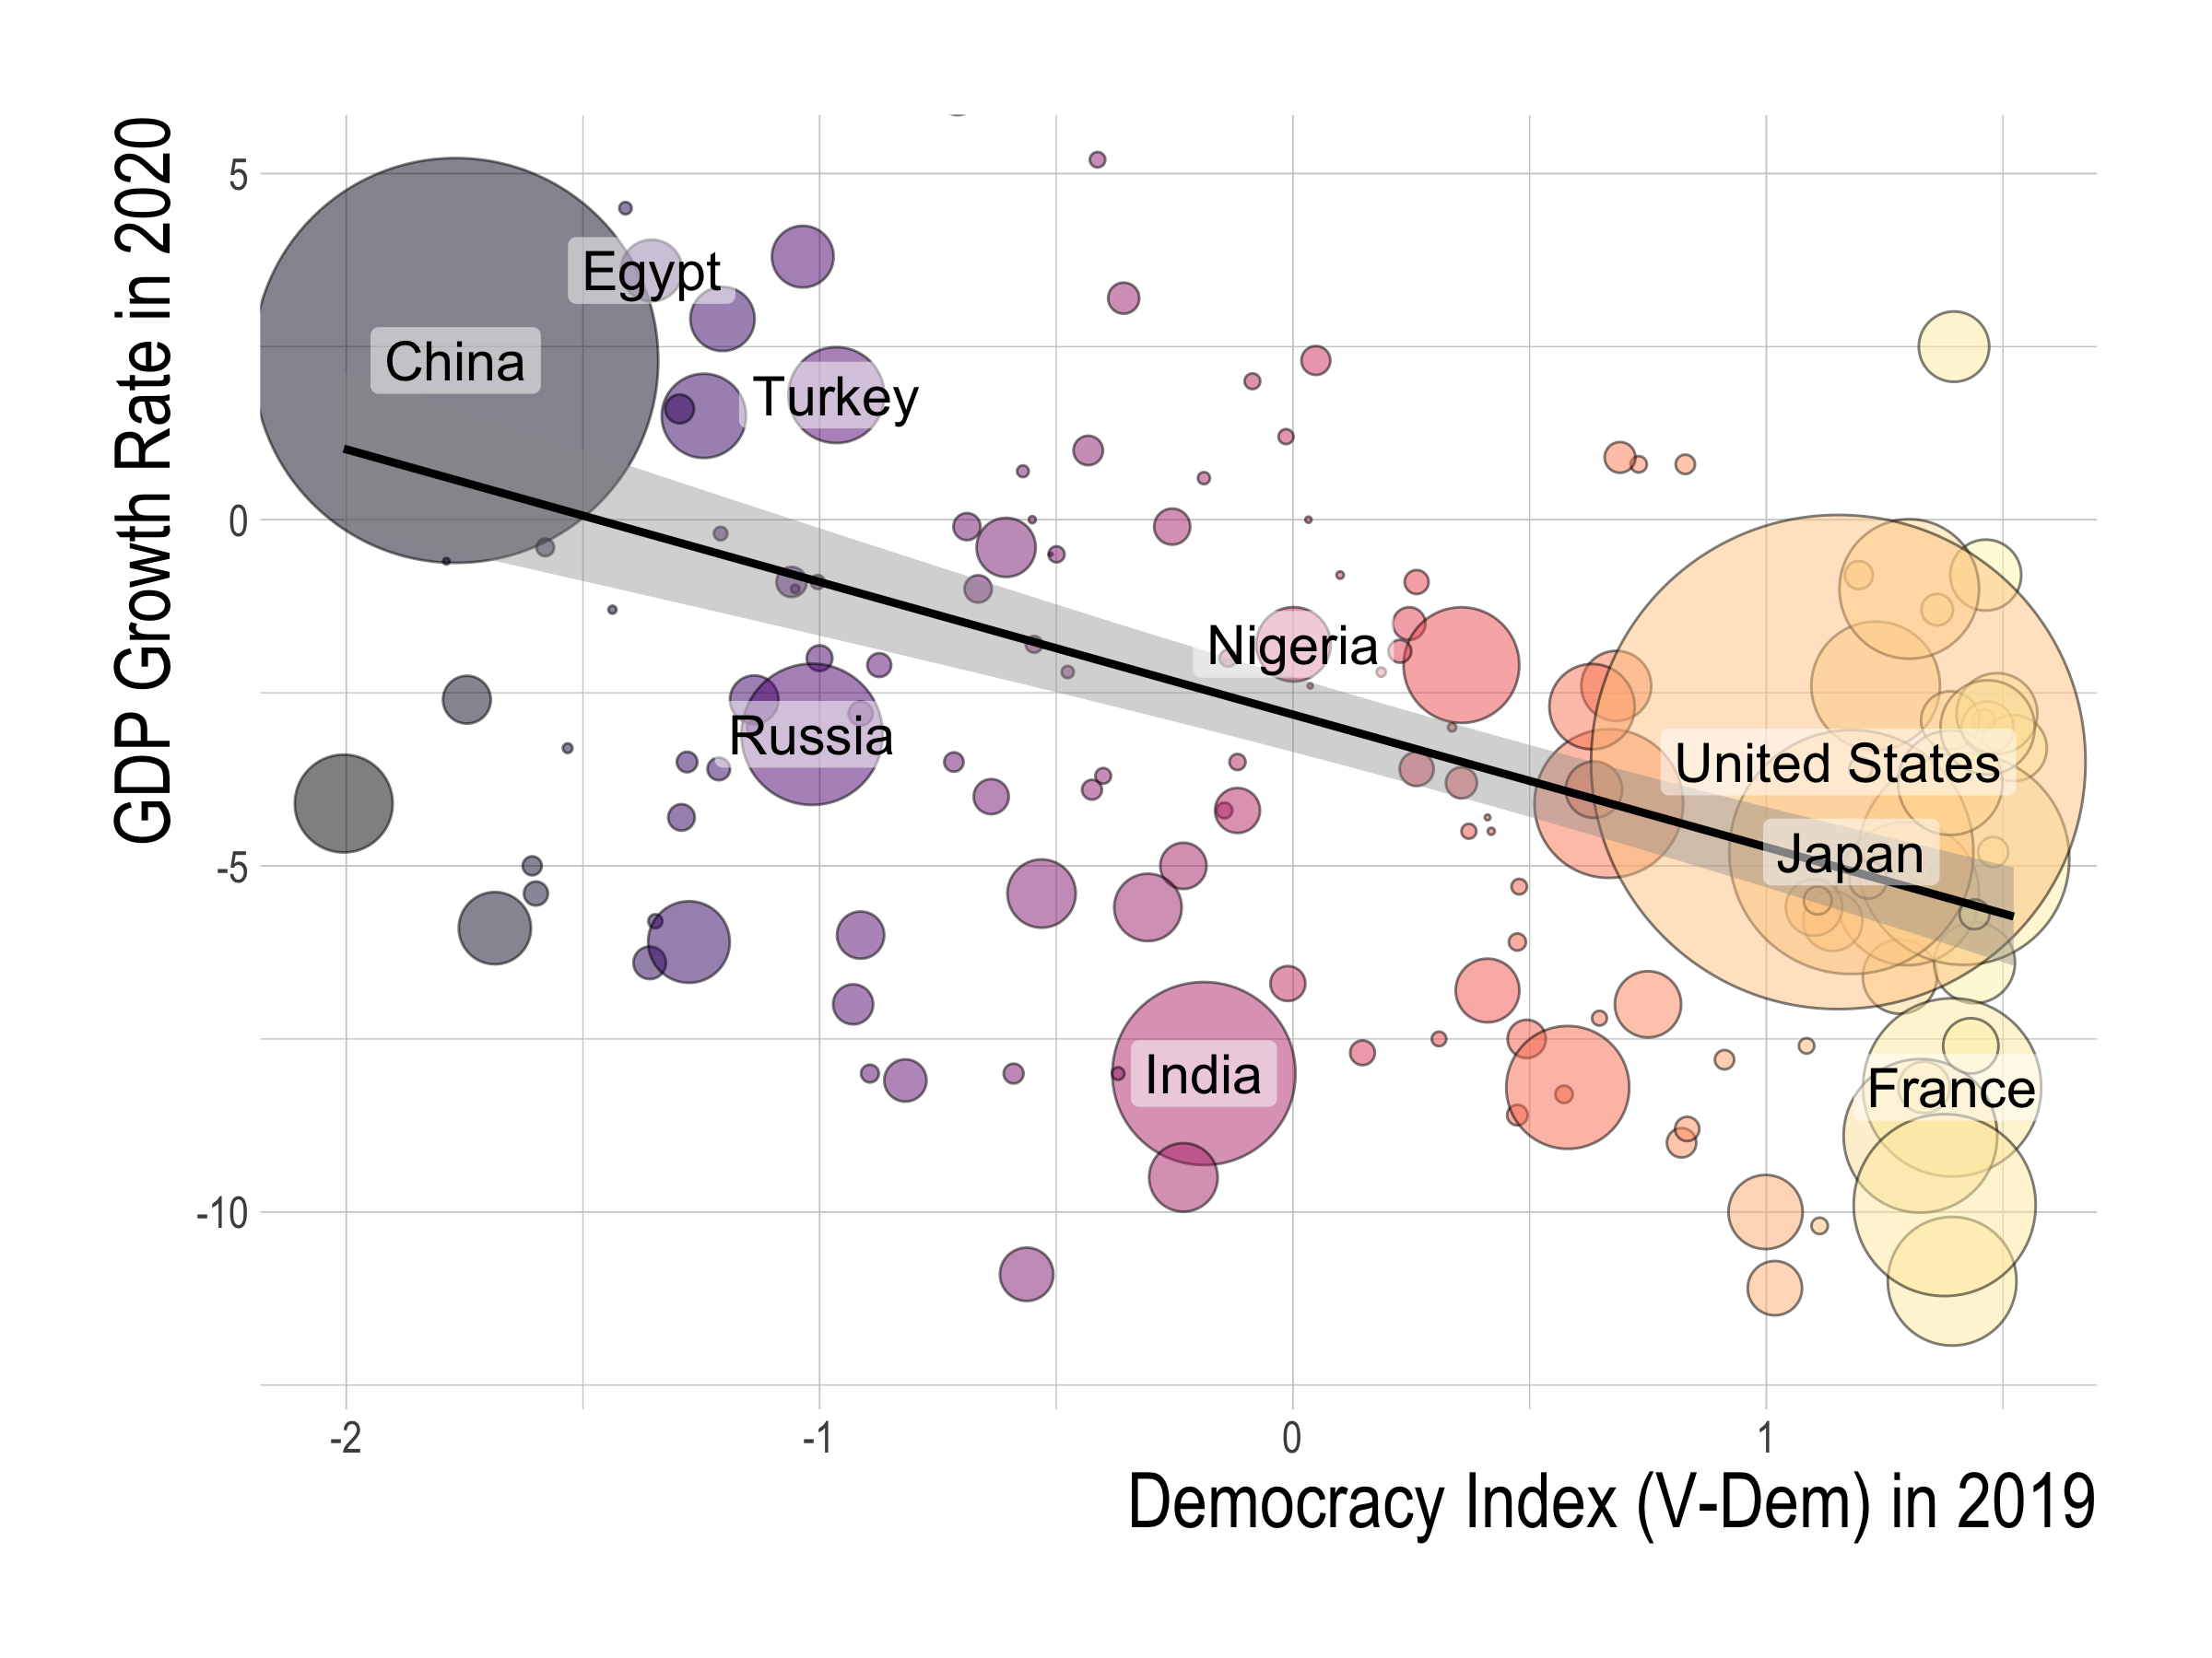

Slide 5
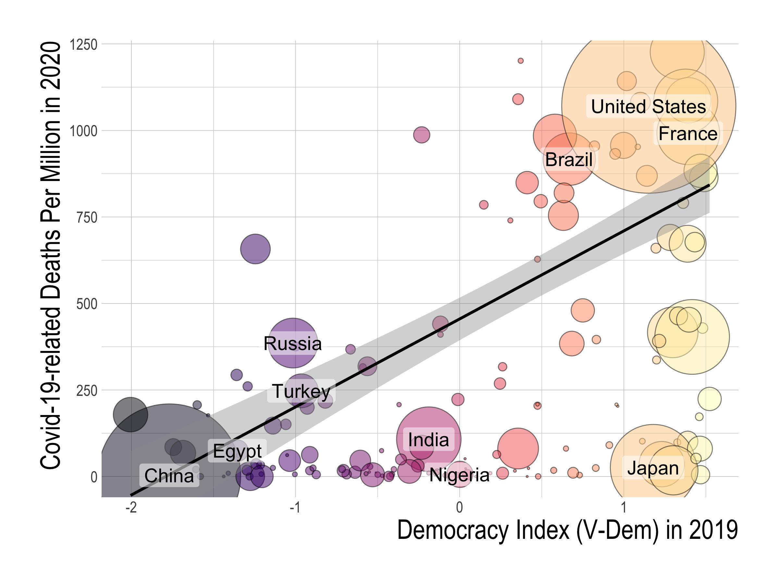
Notes:
.

Slide 6
Our Agenda
Context: Democracy is associated with worse economic & public health outcomes in this century
Question: Do democratic political regimes cause the worse outcomes?
Empirical strategy: 5 of the most influential IVs for political institutions
Notes:
This is the question that we answer in this paper.
Given the context that democracy is strongly associated with worse economic and health outomes in 2020, we ask whether democracy CAUSED these worse outcomes. To do so, we use fve of the ost influential IVs for political and social institutions.

Slide 7
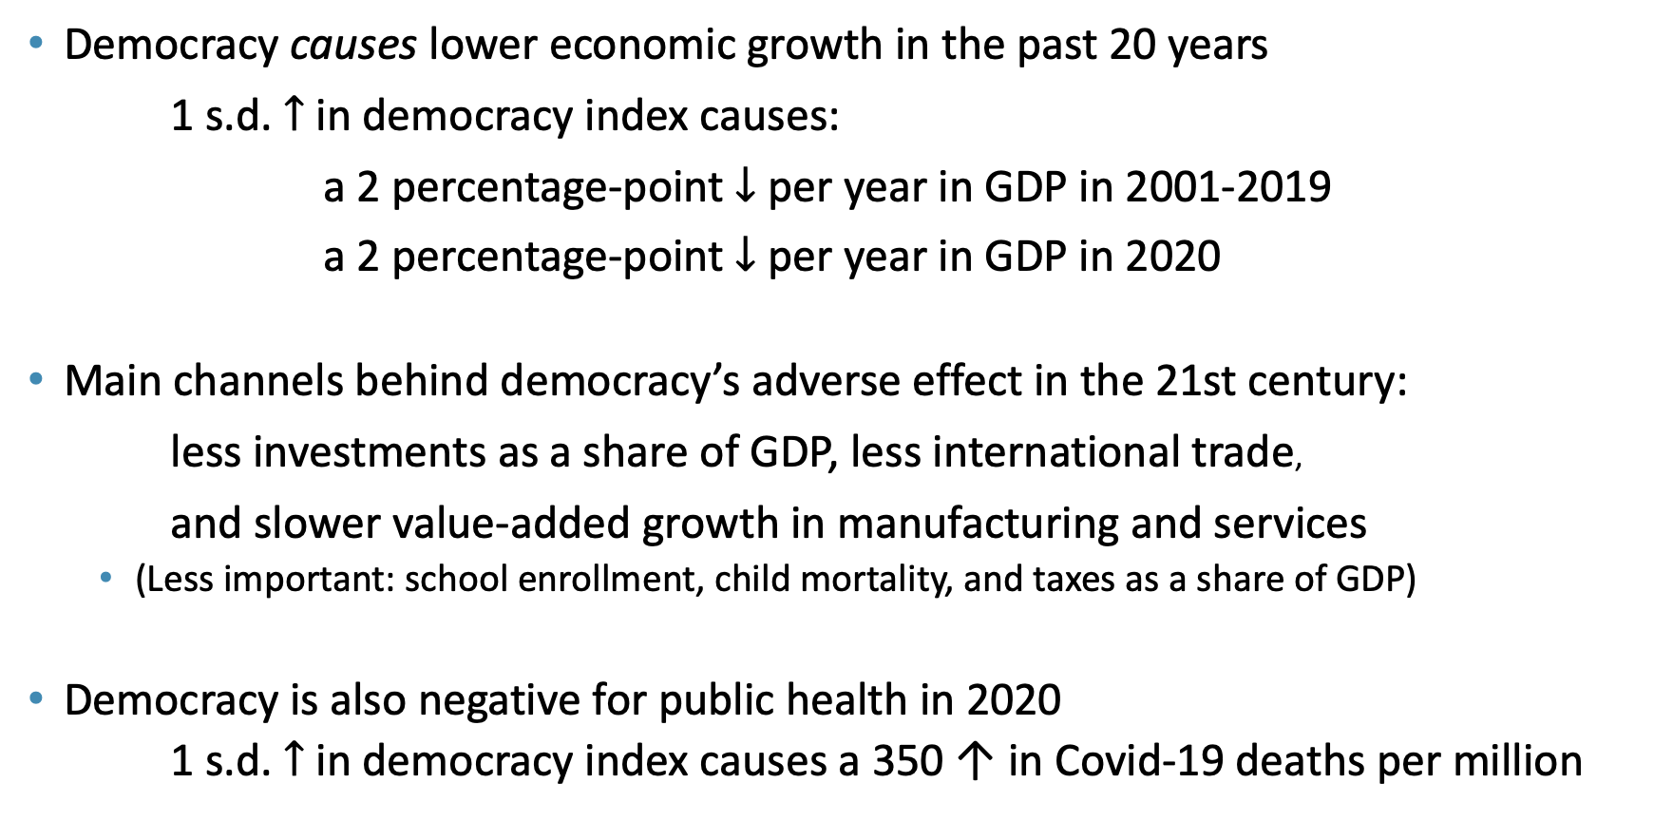
Findings
Democracy causes lower economic growth in the past 20 years
1 s.d. $↑$ in democracy index causes:
a 2 percentage-point $↓$ per year in GDP in 2001-2019
a 2 percentage-point $↓$ per year in GDP in 2020
Main channels behind democracy’s adverse effect in the 21st century:
less investments as a share of GDP, less international trade,
and slower value-added growth in manufacturing and services
(Less important: school enrollment, child mortality, and taxes as a share of GDP)
Democracy is also negative for public health in 2020
1 s.d. $↑$ in democracy index causes a 350 ↑ in Covid-19 deaths per million
Notes:
We find that:
Democracy did cause the worse economic and health outcomes in the pandemic.
a standard deviation increase
a standard deviation difference in democratic levels is equivalent to the political regime difference between Iraq and Indonesia, or Indonesia and France.
The channels behind democracy’s adverse effect

Slide 8
Literature
Democracy, economic growth and public health
Difficult to identify Klenow and Rodriguez-Clare (1997); Durlauf, Johnson and Temple (2005); Helpman (2009); Galor (2011);
Classic cross-sectional regression studies Barro (1997); Przeworski and Limongi (1993); Przeworski et al. (2000).
More quasi-experimental research designs Acemoglu et al. (2018); Aghion, Alesina and Trebbi (2007); Madsen, Raschky and Skali (2015); Papaioannou and Siourounis (2008); Persson and Tabellini (2006); Quinn and Woolley (2001); Rodrik and Wacziarg (2005)
Democracy’s effect on health Besley and Kudamatsu (2006); Gerring, Thacket and Alfaro (2012); Kudamatsu (2012).
More broadly defined Western institutions Acemoglu, Johnson and Robinson (2001, 2002); Easterly and Levine (2003); Hall and Jones (1999)
Economic growth in the 21st century
Global trend towards convergence Kremer, Willis and You (2021)
Improvement in policy outcomes in developing countries Easterly (2019)
China’s unprecedented growth and its effects Song, Storesletten and Zilibotti (2011); Autor, Dorn and Hanson (2016)
Economics of pandemics
Obedience to travel restrictions or compliance with social distancing differ by culture, social capital, government communication, and political systems Frey, Chen and Presidente (2020); Giuliano et al (2020); Karabulut et al (2021); Bosancianu et. al (2020); Schmelz (2021).
Notes:
Our work is at the intersection of two strands of the literature: the relationship among democracy, economic growth, and public health, and the economics of pandemics.

Slide 9
Outline
Data
OLS relationship between democracy and national outcomes
IVs for political regimes
Results
Democracy’s causal effect
Channels behind democracy’s effect
Conclusion
Notes:
This presentation will proceed as follows:
1. Describe our data on Covid-19 outcomes and democracy
2. Explore the OLS relationship between democracy and Covid-19 outcomes to establish that democracy is significantly associated with worse outcomes.
3. Then, we explain our empirical strategy and describe our five different sets of IVs which we use to identify democracy’s effect.
4. After explaining the empirical strategy, we move on to democracy’s causal effect and the channels behind it.
Then, we conclude.

Slide 10
Outline
Data
OLS relationship between democracy and national outcomes
IVs for political regimes
Results
Democracy’s causal effect
Channels behind democracy’s effect
Conclusion
Notes:
This presentation will proceed as follows:
1. Describe our data on Covid-19 outcomes and democracy
2. Explore the OLS relationship between democracy and Covid-19 outcomes to establish that democracy is significantly associated with worse outcomes.
3. Then, we explain our empirical strategy and describe our five different sets of IVs which we use to identify democracy’s effect.
4. After explaining the empirical strategy, we move on to democracy’s causal effect and the channels behind it.
Then, we conclude.

Slide 11
Data on outcomes
GDP growth rates
World Economic Outlook by the International Monetary Fund
Total number of deaths per million attributed to Covid-19 in 2020
Covid-19 Data Repository Center for Systems Science and Engineering at Johns Hopkins University
Notes:
In our paper, we focus on two outcomes: the GDP growth rate in 2020 and the total number of deaths per million attributed to Covid-19.
We focus on these two outcomes because they are not only important but also less susceptible to selective reporting than other outcomes, such as the number of COVID-19 cases.
We obtain data for GDP growth rates in 2020 from the World Economic Outlook report by the International Monetary Fund. Note that these are estimates, as the official numbers take a while to be established and publicized in a consistent way.
For the total number of deaths per million attributed to Covid-19, we source data from the Covid-19 repository center for systems science and engineering at Johns Hopkins university. They are cited by many papers and media outlets and source official counts from local administrative sources.

Slide 12
Data on democracy
V-Dem’s electoral democracy index
0-1 scale index that aggregates indices measuring freedom of association, clean elections, freedom of expression, elected officials, and suffrage
Widely used in the literature Alesina, Tabellini, and Trebbi (2017)
Alternative measures:
Center for Systemic Peace’s polity index
Freedom House’s freedom index
Economist Intelligence Unit’s democracy index
Notes:
Next, on our data for democracy.
Measuring the extent of democracy is tricky.
Thankfully, there are several widely accepted indices that attempt to put a number on the levels of democracy around the world in an unbiased manner.
The baseline measure which we adopt is the index released by an international think tank called Freedom House in their report, Freedom in the World 2020.
What they do is to give each country 0 to 4 points for 10 political rights indicators and 15 civil liberties indicators. The democracy index is the sum of these sub-scores.
Although this index is trusted by many scholars in the field, we test the robustness of our results by adopting alternative measures for democracy, namely those by the Center for Systemic Peace and the Economist Intelligence Unit. We find that they provide similar results.

Slide 13
Outline
Data
OLS relationship between democracy and national outcomes
IVs for political regimes
Results
Democracy’s causal effect
Channels behind democracy’s effect
Conclusion
Notes:
This presentation will proceed as follows:
1. Describe our data on Covid-19 outcomes and democracy
2. Explore the OLS relationship between democracy and Covid-19 outcomes to establish that democracy is significantly associated with worse outcomes.
3. Then, we explain our empirical strategy and describe our five different sets of IVs which we use to identify democracy’s effect.
4. After explaining the empirical strategy, we move on to democracy’s causal effect and the channels behind it.
Then, we conclude.

Slide 14
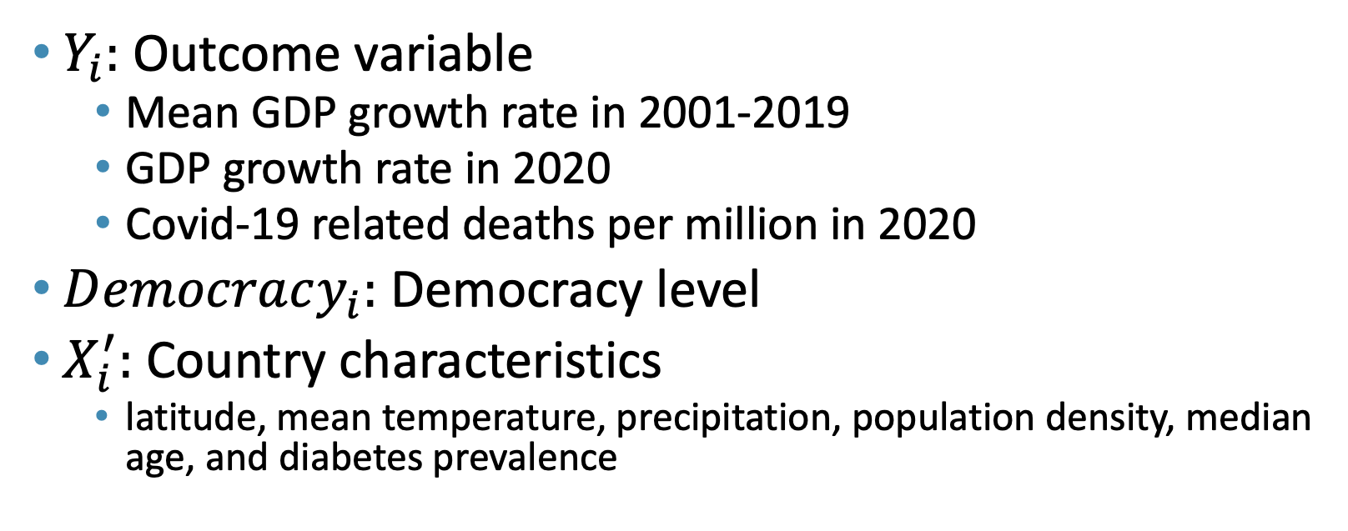
Empirical specification
${ Y}_{i}=μ+αDemocracy_{i}+X_{i}^{′}γ+ε_{i}$
$Y_{i}:$ Outcome variable
Mean GDP growth rate in 2001-2019
GDP growth rate in 2020
Covid-19 related deaths per million in 2020
$Democracy_{i}:$ Democracy level
$X_{i}^{′}:$ Country characteristics
latitude, mean temperature, precipitation, population density, median age, and diabetes prevalence
Notes:
Our simple empirical specification is as follows.
On the left hand side of the equation if our outome variable : either the GDP growth rate in 2020 or the Covid-19-related deaths per million in 2020.
Our main explanatory variable is the level of democracy captured by the democracy index by Freedom House.
We also include controls for other country characteristics that could also determine outcomes in 2020. These are latitude,

Slide 15
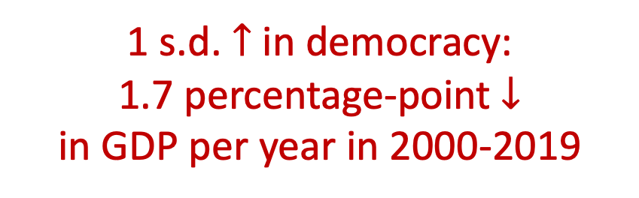
1 s.d. $↑$ in democracy:
1.7 percentage-point $↓$
in GDP per year in 2000-2019
Notes:
This observation is supported by our OLS regression result. This blue line is the fitted OLS regression line that we get with a regression of the democracy index against the GDP growth rate that weights each country by GDP size. The shaded area is the 95% confidence interval.

Slide 16
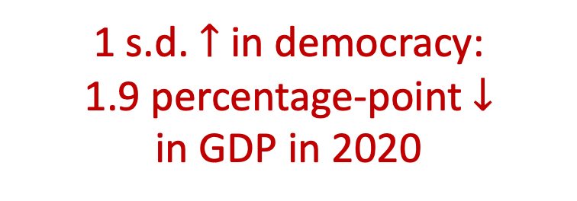
1 s.d. $↑$ in democracy:
1.9 percentage-point $↓$
in GDP in 2020
Notes:
This observation is supported by our OLS regression result. This blue line is the fitted OLS regression line that we get with a regression of the democracy index against the GDP growth rate that weights each country by GDP size. The shaded area is the 95% confidence interval.

Slide 17

1 s.d. $↑$ in democracy:
250 $↑$ Covid-19 related
deaths per million
Notes:
Our OLS regression results, as captured by the blue regresison line, shows that higher levels of democracy correspond to more deaths from Covid-19.

Slide 18
Outline
Data on economic and public outcomes and democracy
OLS relationship between democracy and national outcomes
IVs for political regimes
Results
Democracy’s causal effect
Channels behind democracy’s effect in 2020
Conclusion
Notes:
We cannot interpret the observed OLS relationship as causal, however, because there are likely to be many omitted determinants of outcomes that also correlate with democracies.
Hence, to identify the causal effect of democracy, we adopt five IVs to conduct IVal variables analysis. Now, we describe these IVs and our empirical strategy in more detail.

Slide 19
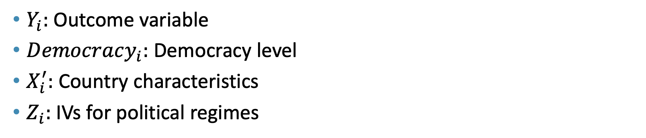
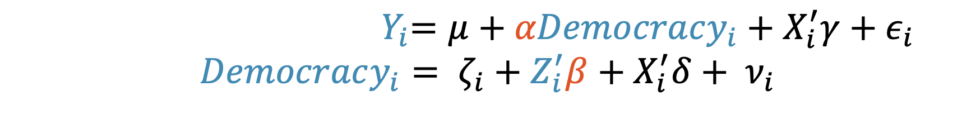
Empirical specification
${ Y}_{i}=μ+αDemocracy_{i}+X_{i}^{′}γ+ε_{i}$
$$Democracy_{i}= ζ_{i}+Z_{i}^{′}β+X_{i}^{′}δ+ ν_{i}$$
$Y_{i}:$ Outcome variable
$Democracy_{i}:$ Democracy level
$X_{i}^{′}:$ Country characteristics
$Z_{i}:$IVs for political regimes
Notes:
Our empirical specification is as follows:
The equation at the top, which is our second-stage equation, is the same as our OLS equation, where we have Covid-19 outcomes on the left side, and our main explanatory variable, democracy levels, on the right hand side.
The difference now is that, since democracy is far from randomly assigned, we introduce a first-stage equation that has democracy as the outcome variable and IVs for political regimes, captured by Z, as the main explanatory variable.

Slide 20
IVs for political regimes
We adopt 5 IV strategies based on several centuries of world history
European settler mortality (Acemoglu-Johnson-Robinson 01)
Past population density (AJR 02)
Legal origin (LaPorta-Shleifer-Vishny 98)
% speaking English or European (Hall-Jones 99)
Availability of crops & minerals (Easterly-Levine 03)
Notes:
So what kind of IVs actually exist? In our paper, we adopt five IV strategies that considers several centuries of world history. We use these with the expectation that they work as robustness checks against each other.
Five instrumental variables strategies:
European settler mortality
Fraction speaking English or European, and the Frankel-Romer trade share
Legal origin
Availability of crops and minerals
Past population density
These IVs help identify the effects of political institutions by tracing back their origins to geographical and his- torical determinants such as the feasibility and incentives of colonial powers to invest in institution-building, the origin of the legal institution, and natural resource endowments. Indeed, first-stage regressions show that several of these IVs are significant drivers of the cross-country variation in today’s democracy levels.

Slide 21
1. European settler mortality IV
Acemoglu, Johnson and Robinson (2001)
Mortality rate of European soliders, bishops, and sailors in 17th~19th centuries
Use mainly among former European colonies
European settler mortality
Colonial
institutions
Political
regimes
Notes:
First suggested by Acemoglu, Johnson, and Robinson (2001) as an IV for political and social institutions.
Mortality rate of soldiers, bishops, and sailors stationed in the colonies between the seventeenth and nineteenth centuries.

Slide 22
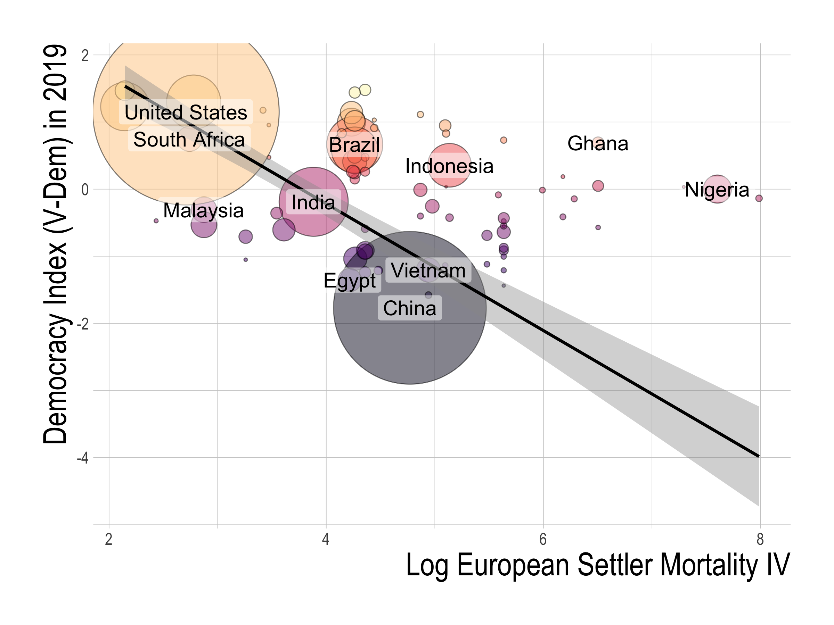

Slide 23
2. Past Population Density
Acemoglu, Johnson and Robinson (2002)
Number of inhabitants per square kilometer in the 16th century
Use mainly among former European colonies
Population
Density in 16th century
Colonial
Institutions
Political
Regimes
Notes:
Our fifth instrumental variable strategy uses past population density, as suggested by Acemoglu, Johnson, and Robinson. This variable records the number of inhabitants per square kilometer in the 16th century.
It works as an instrument because population density at the beginning of the 16th century determined how inclusive or exclusive colonial institutions were.
Sparse populations induced Europeans to settle themselves and develop more inclusive colonial institutions.
On the other hand, more dense local populations meant more slave labor and more wealth to extract, which resulted in more exclusive colonial institutions.
The effect of these colonial institutions persist to the present.

Slide 24
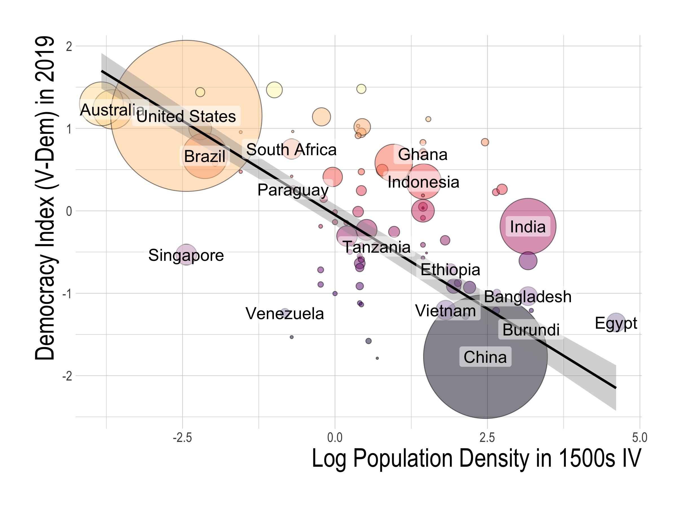

Slide 25
3. Legal Origin
LaPorta, Shleifer, and Vishny (1998)
Dummy variable for British legal origin that is coded 0 if the legal origin is British (common-law) and coded 1 if the country’s legal origin is French, German, or Scandinavian
Use mainly among former European colonies
Legal
Origin
Legal
Infrastructure
Political
Regimes
Notes:
Our third instrument is legal origin, suggested by LapPorta, Shleifer, and Vishny.
These are dummy variables that are turned on if the country’s legal origin is English, French, or German.
Why are these valid instruments?
Many countries derived their legal systems from colonization by one of these European powers.
Such legal origin determined the general legal infrastructure and influenced how the law protects civil liberties and political rights today, which is significantly correlated with political regimes.
By having separate dummies for legal origin, we allow them to have varying effects on political institutions today.

Slide 26
4. Fraction speaking English or Western European
Hall and Jones (1999)
Fraction of a country’s population speaking English or a major Western European language (French, German, Portuguese, or Spanish) as a mother tongue in 1992
Include all countries in the sample (for which we have data)
Fraction Speaking Western European
Western European
Influence
Political
Regimes
Notes:
Our second instrumental variables strategy uses a set of three instruments proposed by Hall and Jones that consist of the fraction speaking English or European, and the Frankel-Romer trade share.
The fraction speaking English or European is the fraction of a country’s population speaking English or a major Western European language (French, German, Portuguese, or Spanish) as a mother tongue in 1992.
The Frankel-Romer trade share is the predicted share of each country’s economy occupied by international trade, based on the gravity model. Put simply, this gravity model considers a country’s geographic characteristics, such as its distance from neighboring countries to estimate how susceptible a country’s geography is to international trade.
But how are these valid instruments?

Slide 27
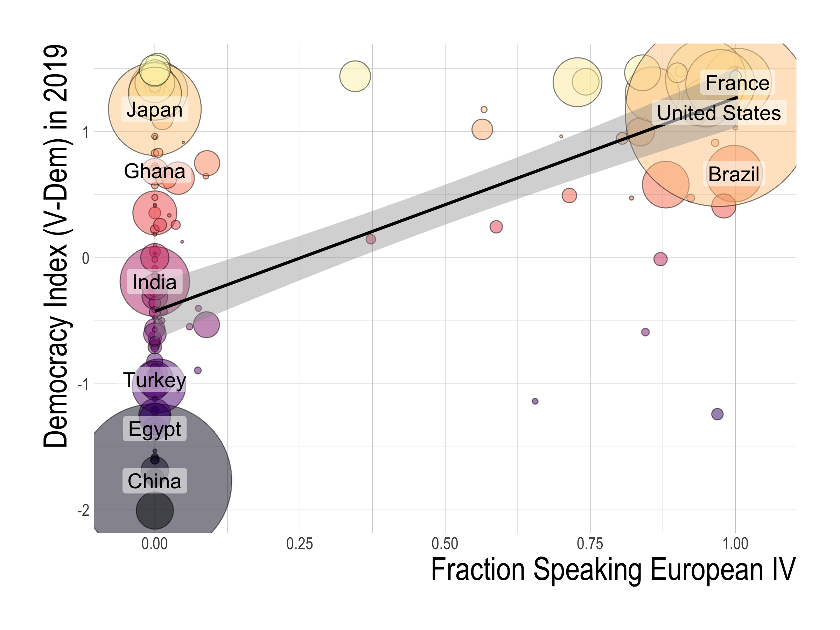

Slide 28
5. Availability of crops and minerals
Easterly and Levine (2003)
Dummy variables for whether a country produced or mined a particular commodity in 1990
Bananas, coffee, copper, maize, millet, rice, rubber, silver, sugarcane, wheat.
Include all countries in the sample (for which we have data)
Economies
of scale
& slave labor
Crops and minerals
Political
Regimes
Notes:
Our fourth instrument is the availability of crops and minerals, suggested by Easterly and Levine.
These are dummy variables for whether a country produced or mined a particular commodity in 1990.
These commodities are bananas, coffee, maize, millet, rice, rubber, sugarcane, and wheat.
These act as valid instruments because, according to historians such as Engermann and Sokoloff, certain commodities encouraged or discouraged economies of scale and the use of slave labor, which led to more inclusive or extractive institutions that laid the groundwork for today’s political regimes.

Slide 29
IVs for political regimes
Five IV strategies:
European settler mortality
Past population density
Legal origin
% speaking English or European
Availability of crops & minerals
Our strategy: the strategies work as robustness checks against each other
Notes:
We are aware that none of these IVs is perfect.
Each IV is likely to be threatened by its own mix of measurement errors, omitted variables, and exclusion violations.
Hence, our strategy is to use these five different IVs with the expectation that they work as robustness checks with each other.

Slide 30
Outline
Data on economic and public outcomes and democracy
OLS relationship between democracy and national outcomes
IVs for political regimes
Results
Democracy’s causal effect
Channels behind democracy’s effect
Conclusion
Notes:
Now, we would like to move on to describing our findings on democracy’s causal effect.
We will first show the results of our reduced form regressions.

Slide 31
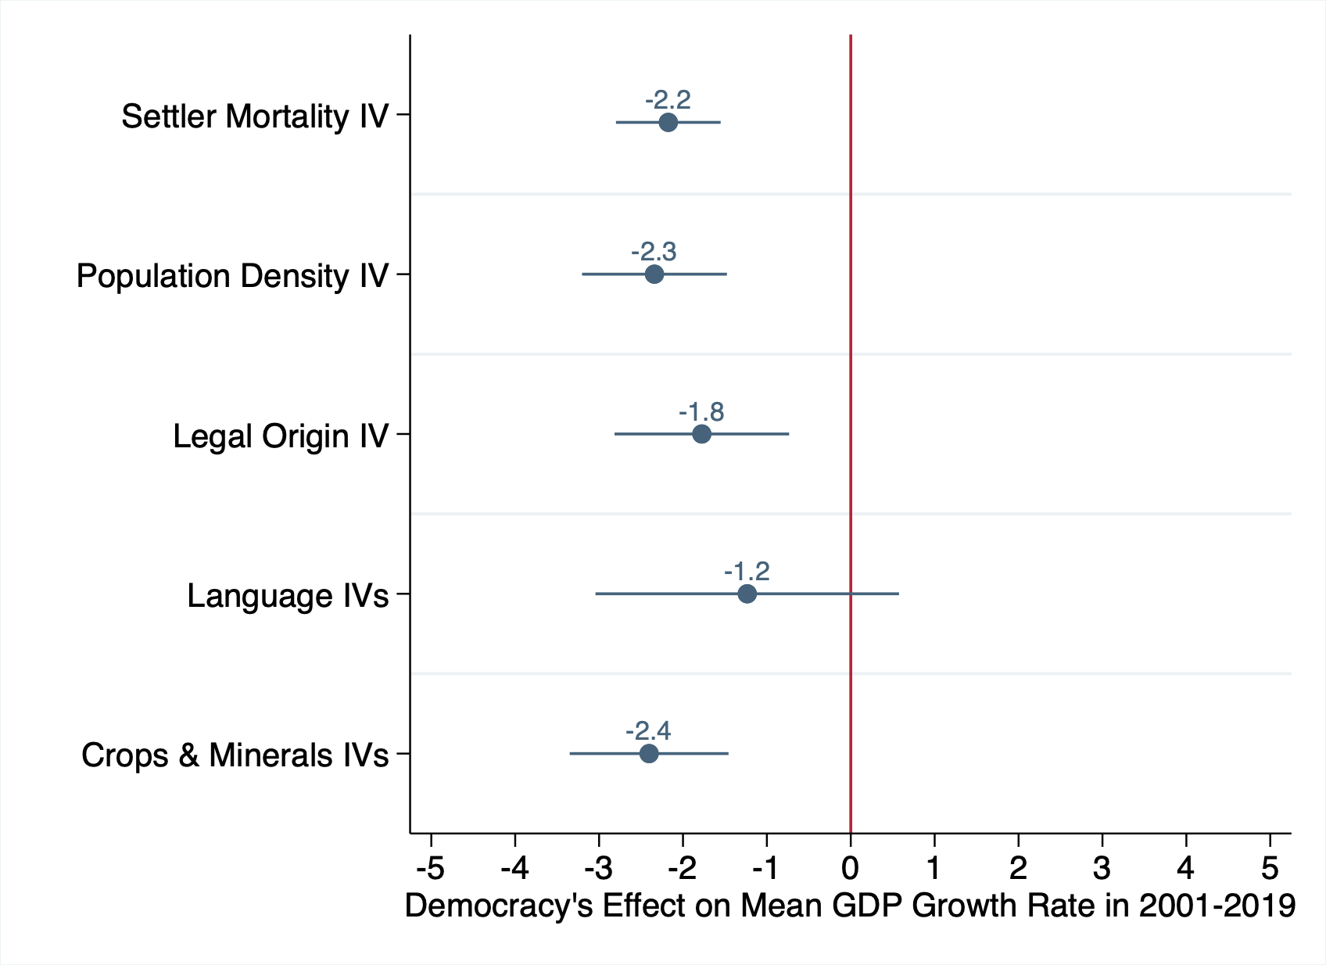
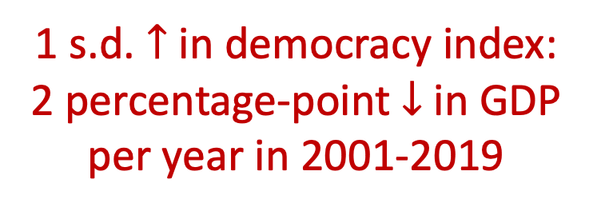
1 s.d. $↑$ in democracy index:
2 percentage-point $↓$ in GDP per year in 2001-2019

Slide 32
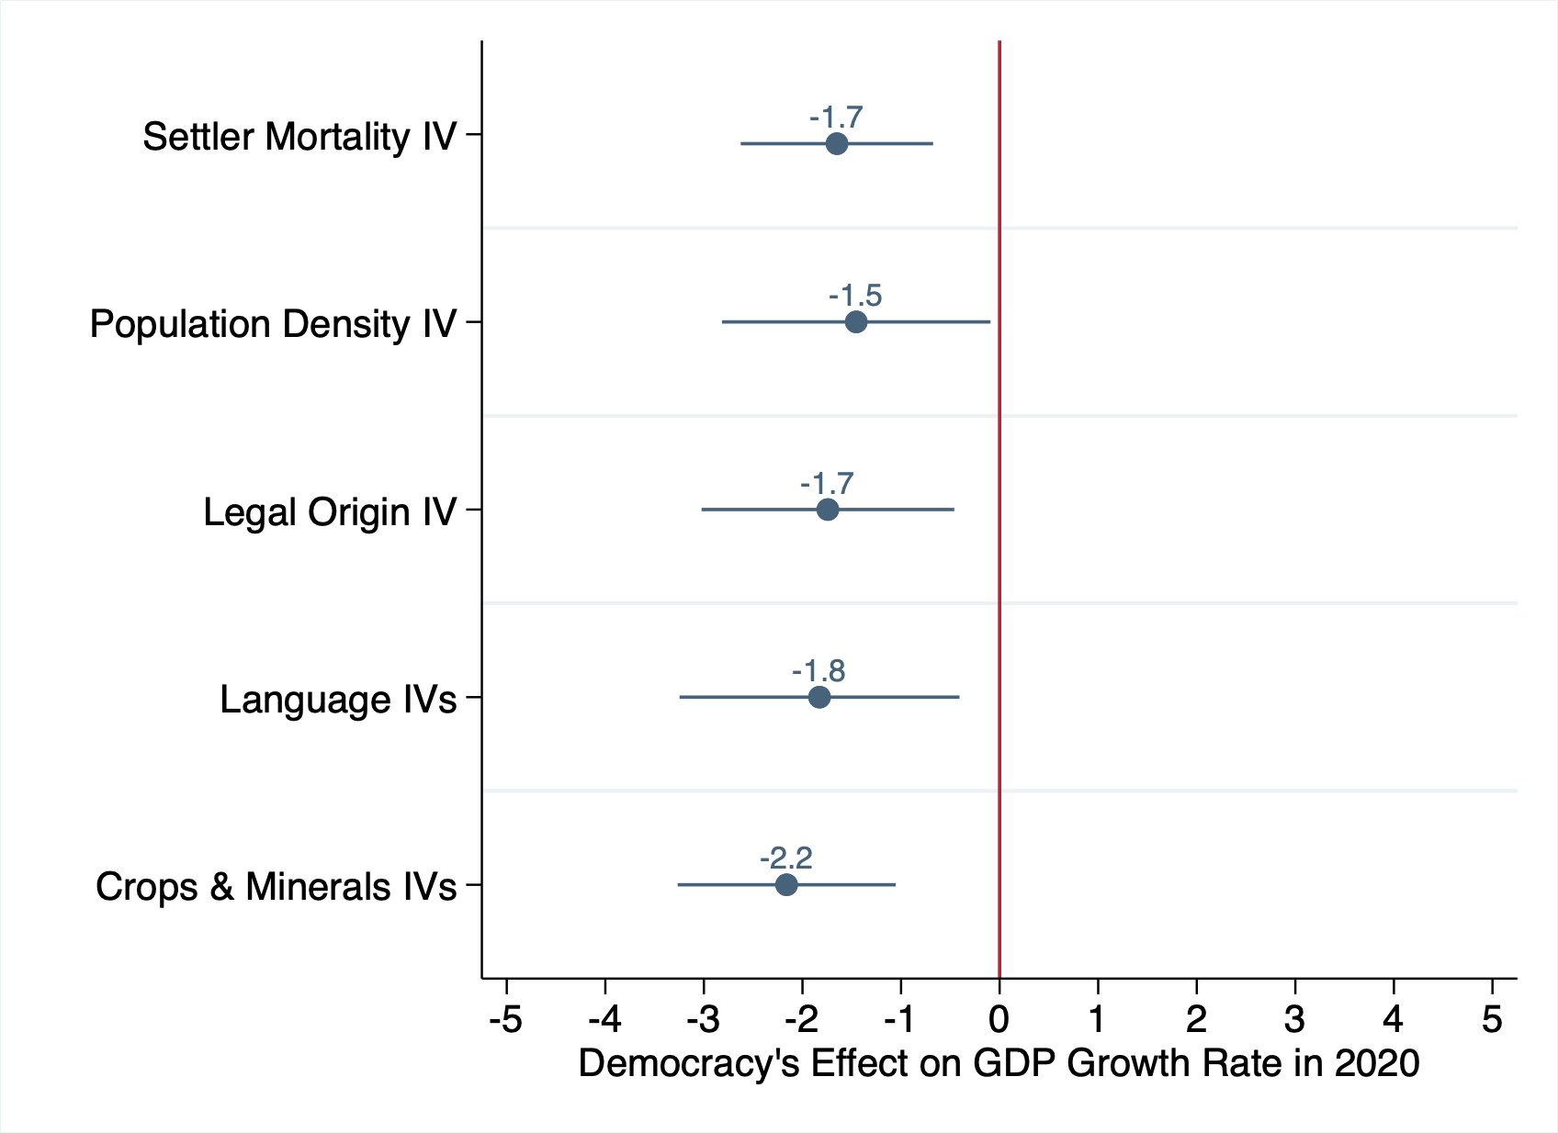
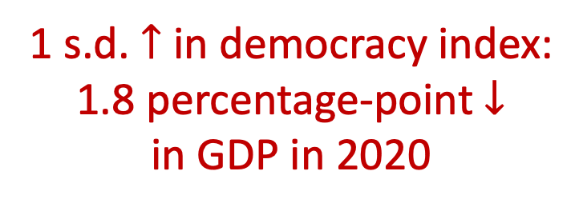
1 s.d. $↑$ in democracy index:
1.8 percentage-point $↓$
in GDP in 2020
Notes:
What we find is that a standard deviation increase in the democracy index (again, as a benchmark, this is equivalent to the political regime difference between Iraq and Indonesia, or Indonesia and France), is caused around a 3 percentage-point decease in GDP between 2019 and 2020.
This is fairly significant effect, given that the average global GDP growth rate in 2020 is -5.7%.

Slide 33
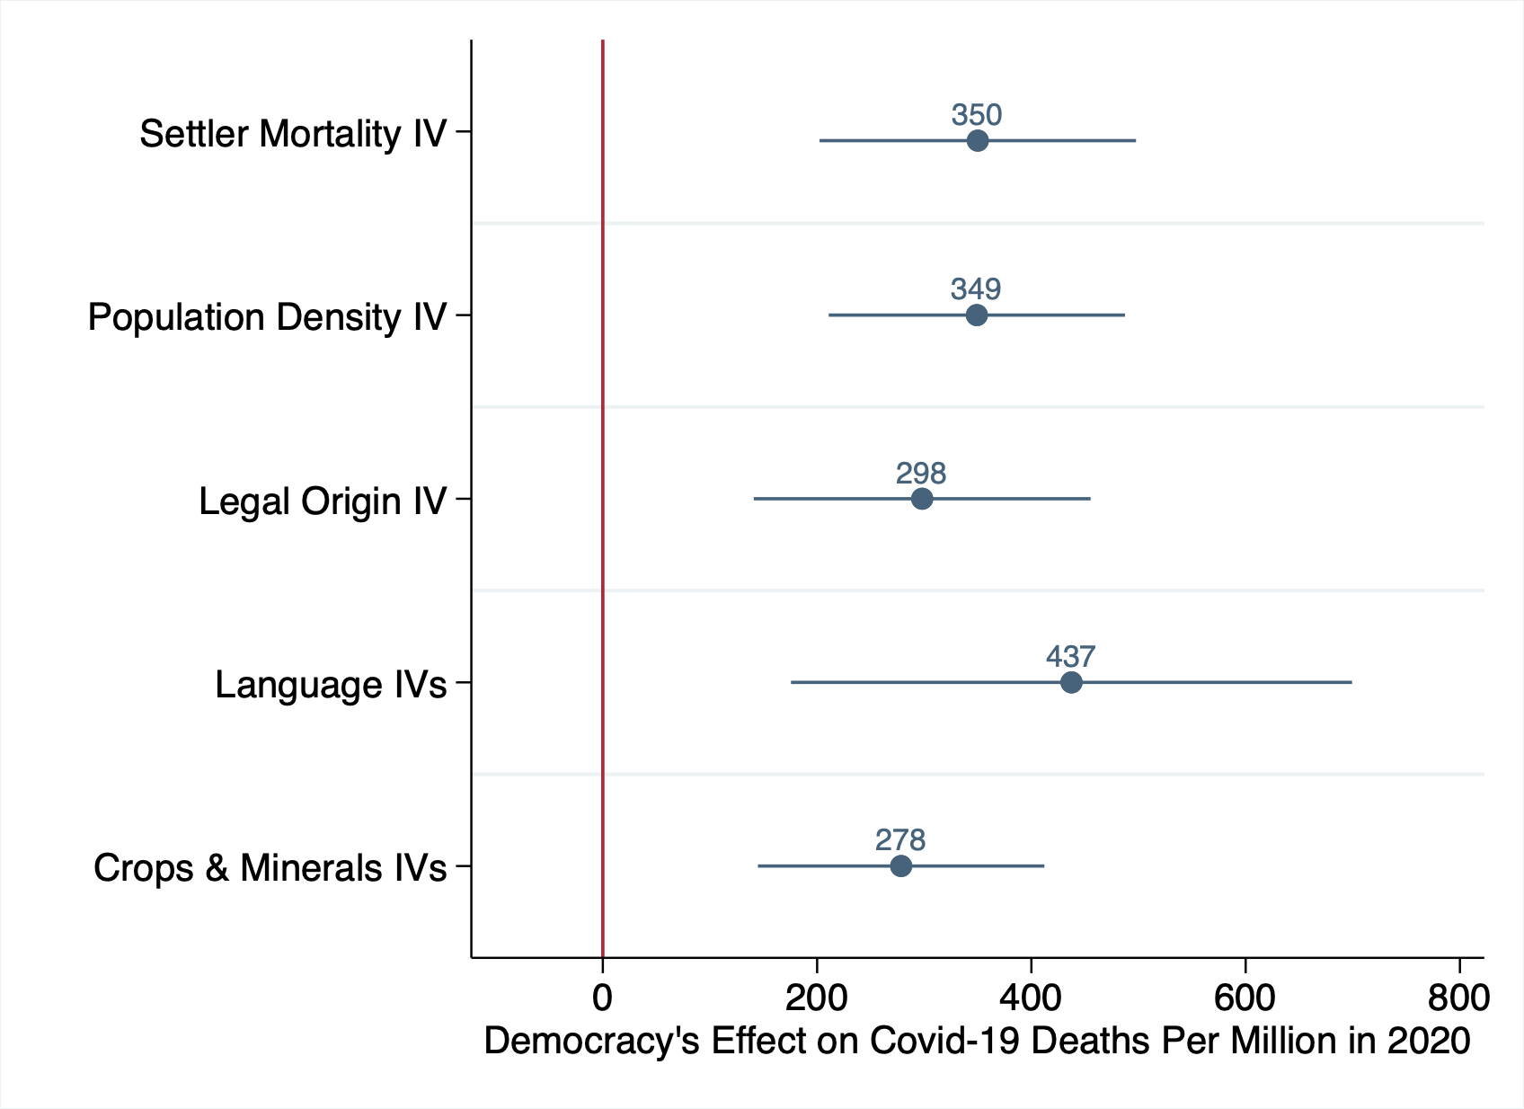
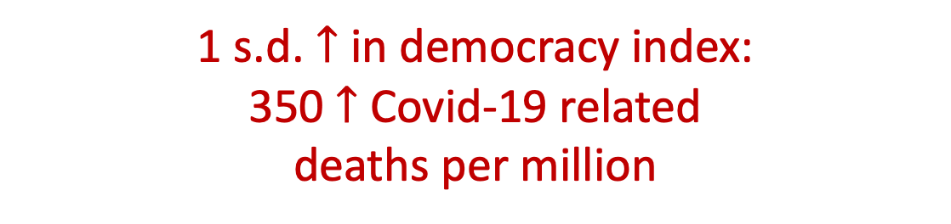
1 s.d. $↑$ in democracy index:
350 $↑$ Covid-19 related
deaths per million
Notes:
We also find a significant causal effect of democracy on Covid-19 deaths per million.
We find that a standard deviation increase in democracy levels caused around a 400 increase in Covid-19-related deaths per million.
As we can see, this result is consistent across the give instrumental variable strategies.
Moreover, this result again implies that democracy is a significant determinant of Covid-19 deaths, given that the global average of Covid-19-related deaths per million is 285.

Slide 34
Robustness
Control for country-characteristics
climate (absolute latitude, mean temperature, mean precipitation), population density, population ageing, and diabetes prevalence
Control for baseline GDP
GDP per capita and total GDP
Alternative democracy indices
polity index by the Center for Systemic Peace, freedom index by Freedom House, and democracy index by the Economist Intelligence Unit
Alternative weightings
no weighting and population weighting
Alternative sample definitions
exclude G7 countries, exclude US & China, exclude outliers with standardized residual above 1.96 or below -1.96
Notes:
Although we do not have time to go into detail today, in our paper, we show that our results are robust to various specifications.
The addition of controls such as climate, population density, population ageing, diabetes prevalence, or service sector share, all of which are plausible determinants of Covid-19 outcomes, does not change our baseline results of a negative effect of democracy.
Neither does using alternative democracy indices, or alternative weighting methods, change our results.
We also establish that our result is a global phenomenon and not driven by US and China alone, by showing that we get similar results even when excluding the US and China from the sample.

Slide 35
Outline
Data on economic and public outcomes and democracy
OLS relationship between democracy and national outcomes
IVs for political regimes
Results
Democracy’s causal effect
Channels behind democracy’s effect
Conclusion
Notes:
Now, we know that democracy did cause the worse outcomes. This begs the question of how. What were the main mechanisms behind democracy’s effect?

Slide 36
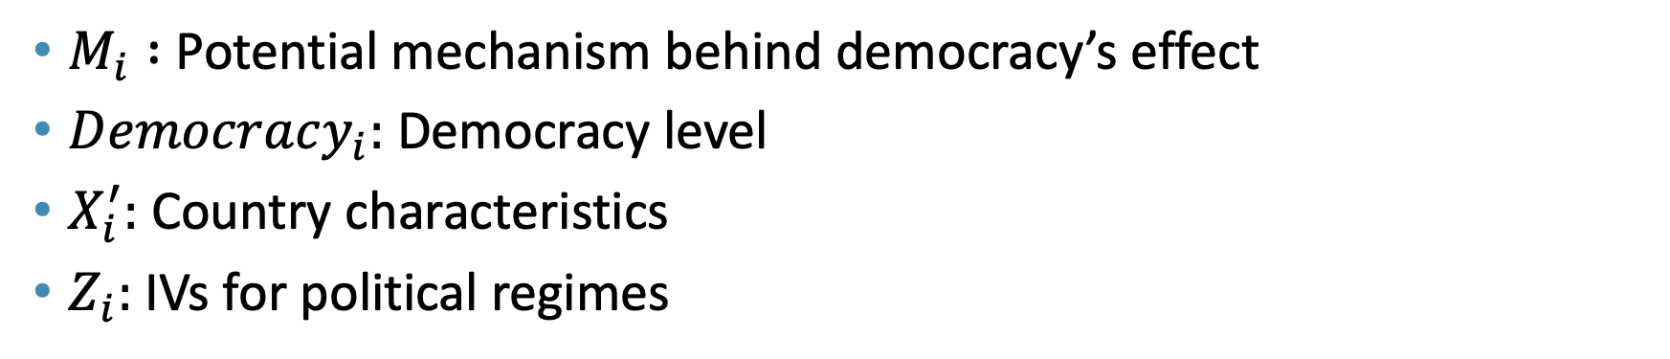
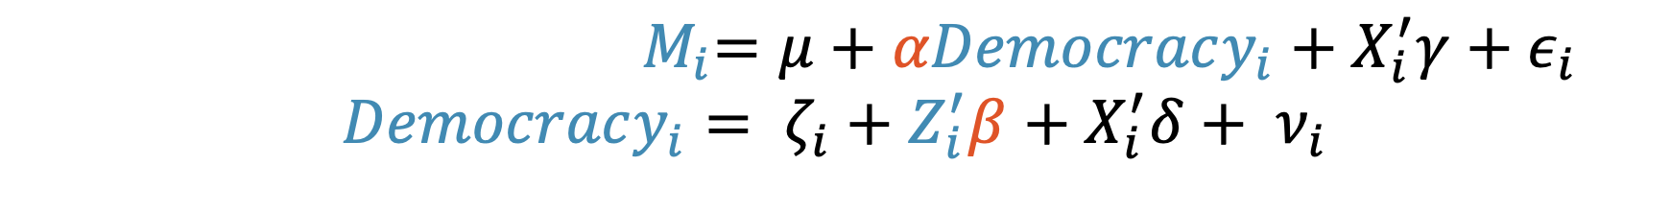
Empirical specification
${ M}_{i}=μ+αDemocracy_{i}+X_{i}^{′}γ+ε_{i}$
$$Democracy_{i}= ζ_{i}+Z_{i}^{′}β+X_{i}^{′}δ+ ν_{i}$$
$M_{i} :$ Potential mechanism behind democracy’s effect
$Democracy_{i}:$ Democracy level
$X_{i}^{′}:$ Country characteristics
$Z_{i}:$IVs for political regimes
Notes:
To explore this empirically, we use the following familiar specification, where we replace our outcome variable Y with M, whichrepresents the potential mechanism behind democracy’s effect.
////Our empirical specification is as follows:
The equation at the top, which is our second-stage equation, is the same as our OLS equation, where we have Covid-19 outcomes on the left side, and our main explanatory variable, democracy levels, on the right hand side.
The difference now is that, since democracy is far from randomly assigned, we introduce a first-stage equation that has democracy as the outcome variable and instruments for political regimes, captured by Z, as the main explanatory variable.

Slide 37
Potential Mechanisms
Mechanisms that turned out to be important:
Investments
International trade
Value added in manufacturing and services
We find a significant negative causal effect in each of these aspects.
Less important: primary school enrollment, secondary school enrollment, child mortality rates, and taxes as a share of GDP

Slide 38
Investment as a share of GDP
Investment: the total value of the gross fixed capital formation and changes in inventories and acquisitions less of disposals of valuables for a unit or sector
Source: International Monetary Fund, World Economic Outlook

Slide 39
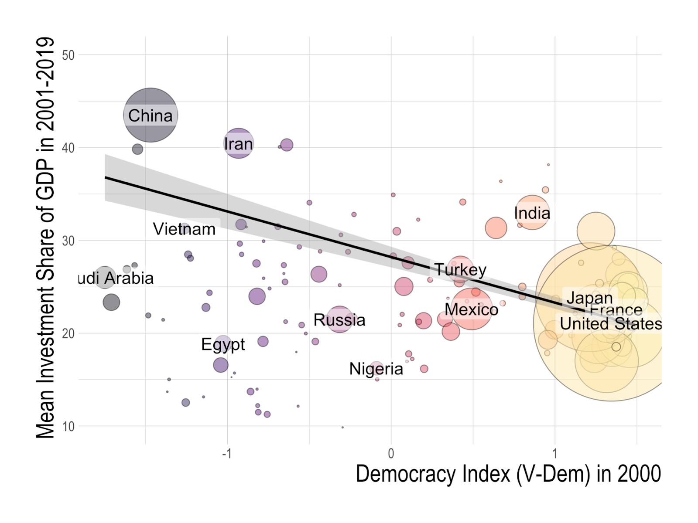

Slide 40
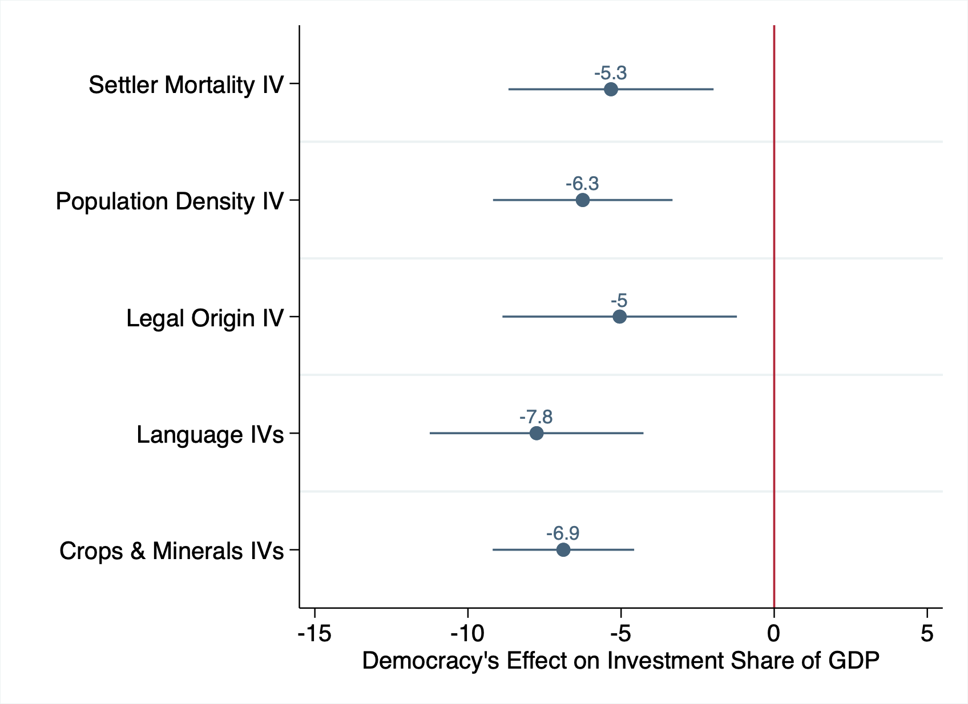
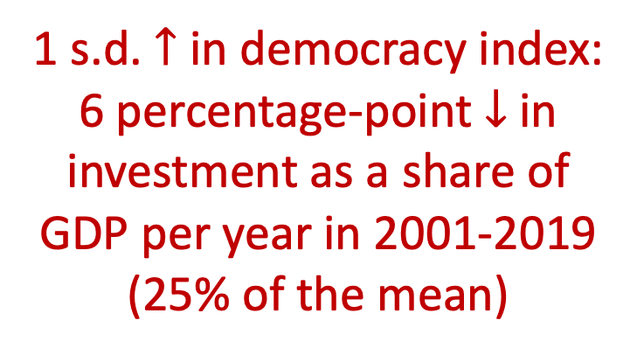
1 s.d. $↑$ in democracy index:
6 percentage-point $↓$ in investment as a share of GDP per year in 2001-2019
(25% of the mean)

Slide 41
Trade
Import value index & export value index: Current value of imports or exports converted to US dollars and expressed as a percentage of that in the base period (2000)
Source: UN Conference on Trade and Development (UNCTAD), Handbook of Statistics and Data Files

Slide 42
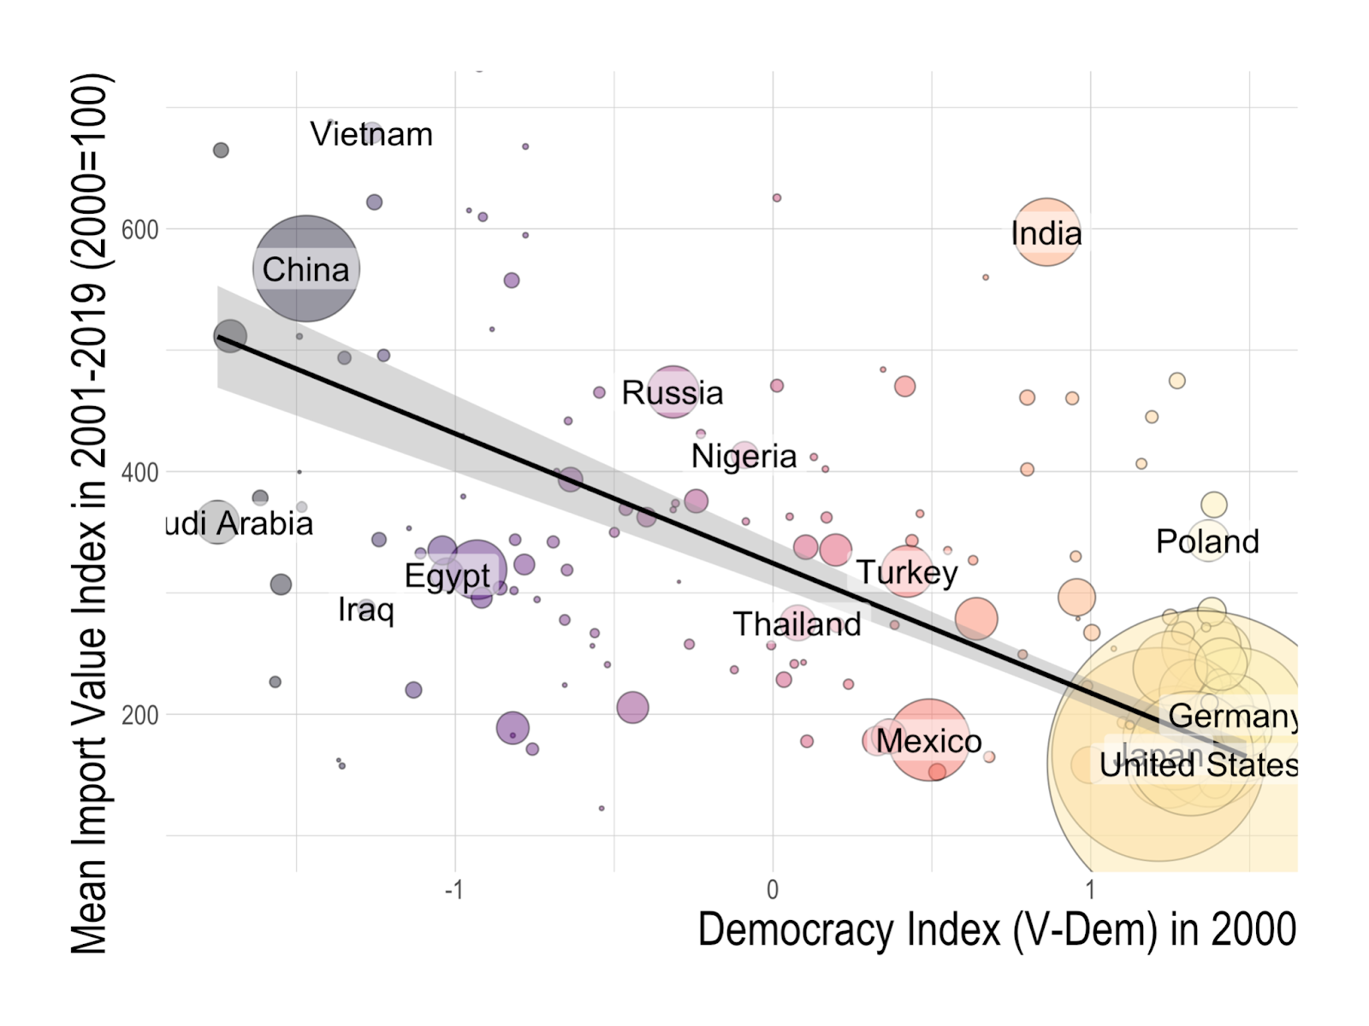

Slide 43
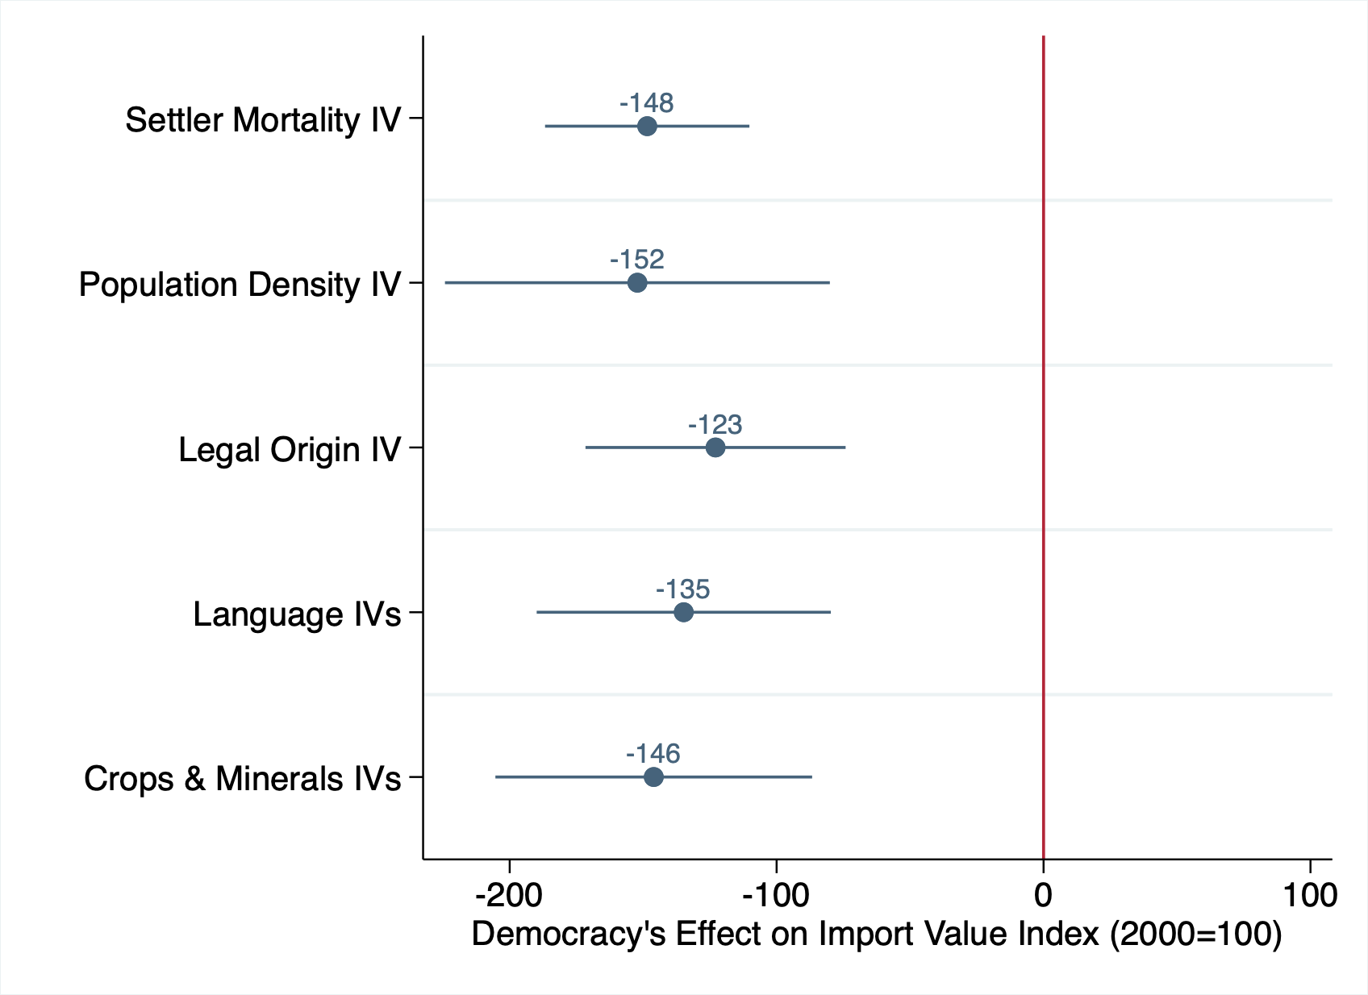
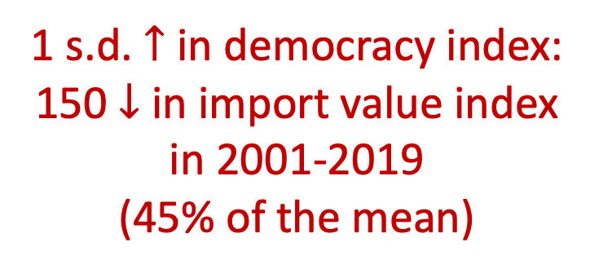
1 s.d. $↑$ in democracy index:
150 $↓$ in import value index in 2001-2019
(45% of the mean)

Slide 44
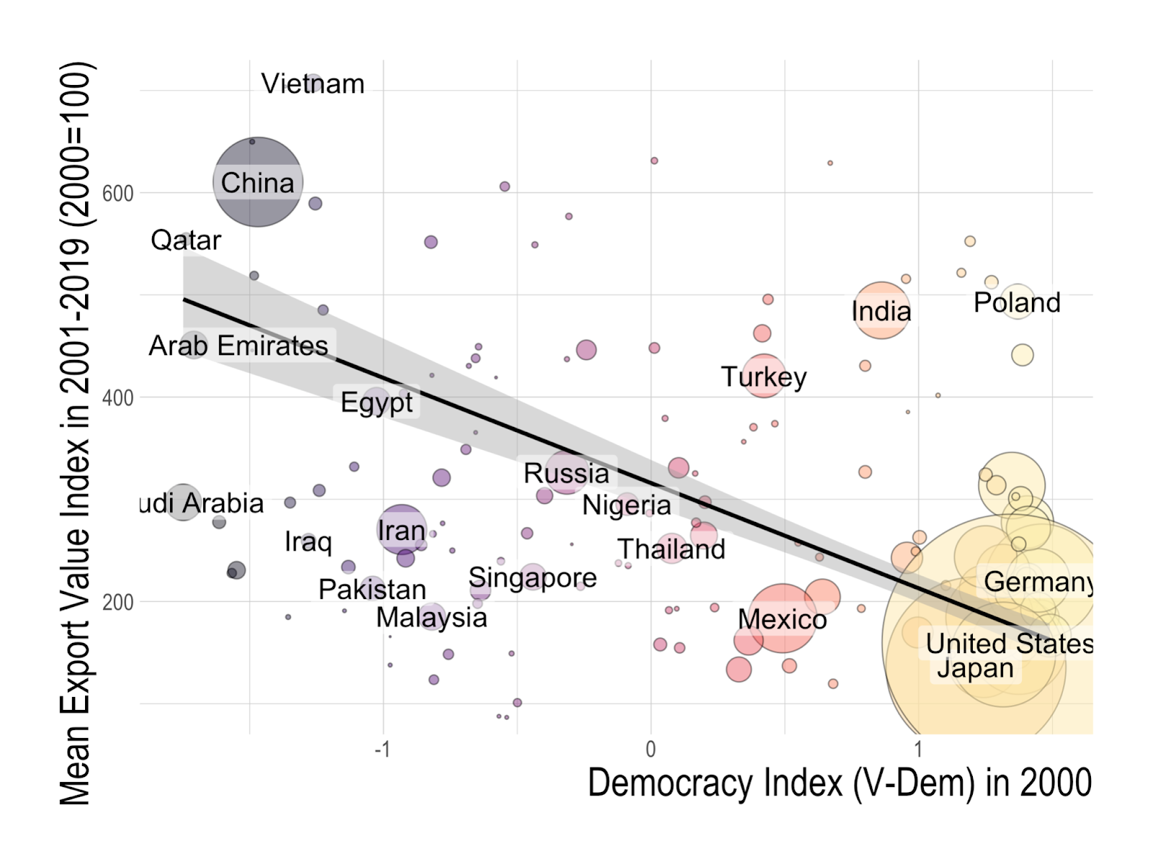

Slide 45
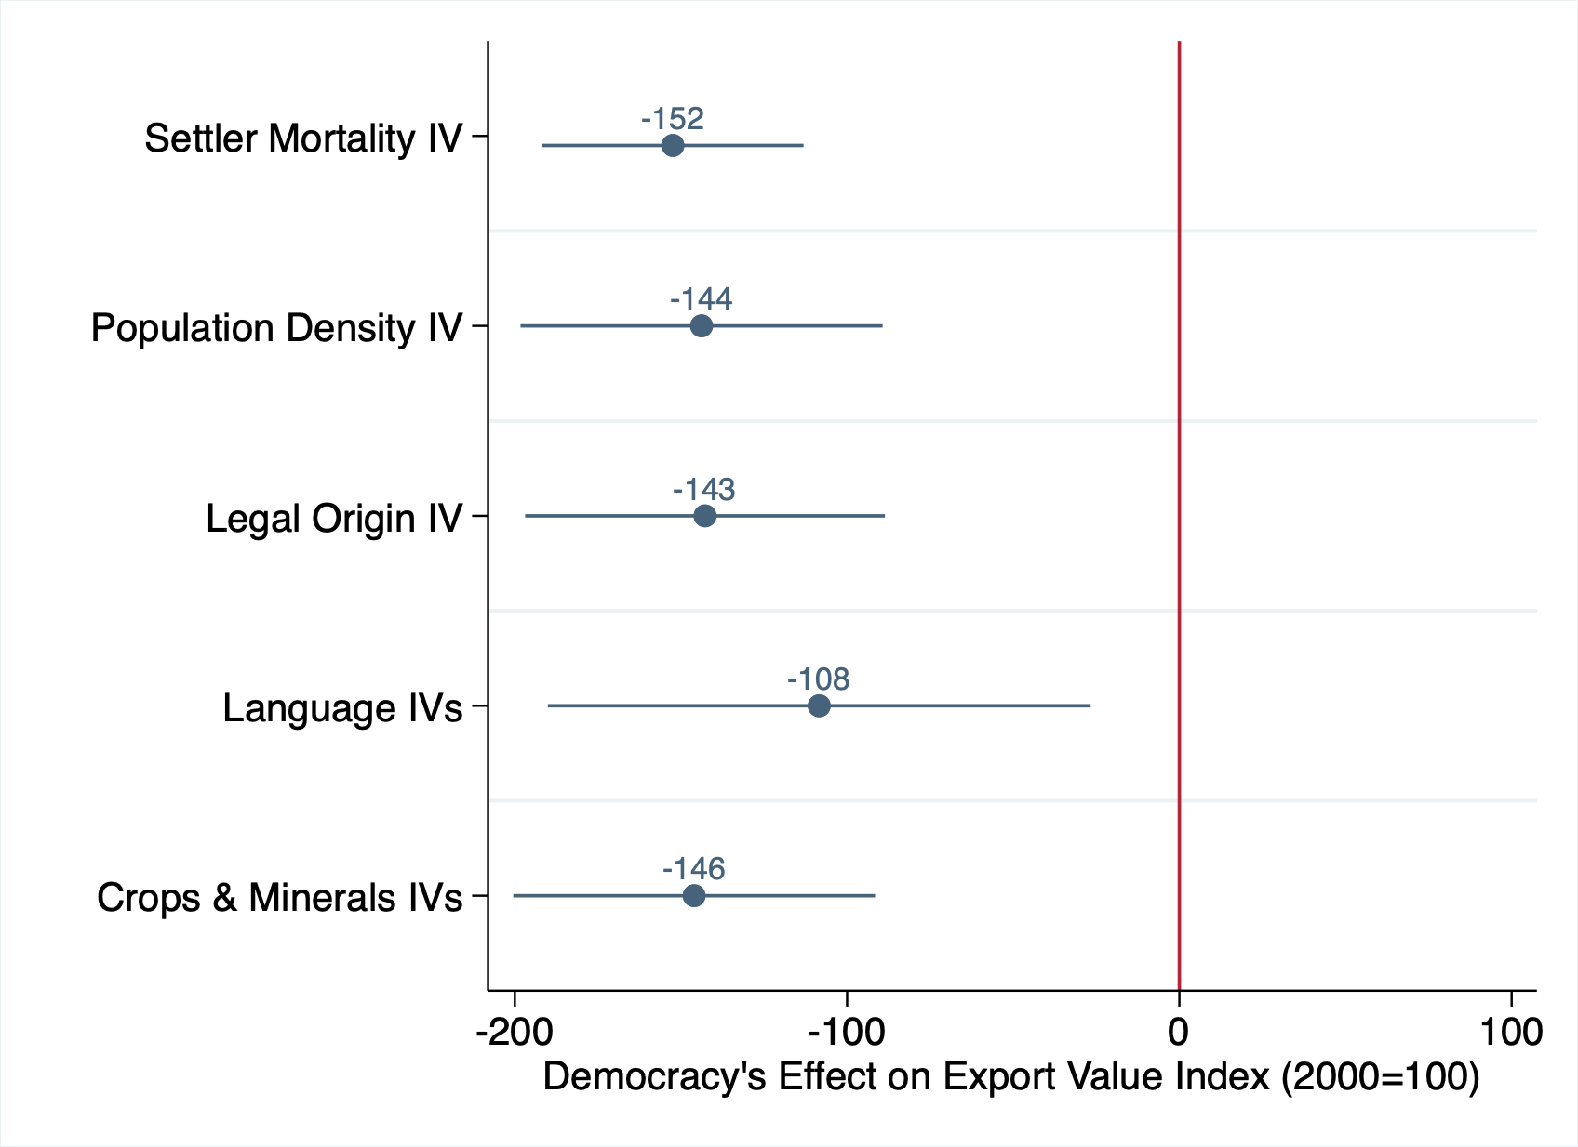

1 s.d. $↑$ in democracy index:
150 $↓$ in export value index in 2001-2019
(40% of the mean)

Slide 46
Value Added in Manufacturing and Services
Manufacturing sector: industries that physically or chemically transform materials into new products
Service sector: any services, for example wholesale and retail trade, transport, education, healthcare, and finance
Value Added: net output of a sector after adding up all output and subtracting intermediate inputs
Look at the annual growth rate in value added in 2001-2019.
Source: World Bank, National Accounts Data

Slide 47
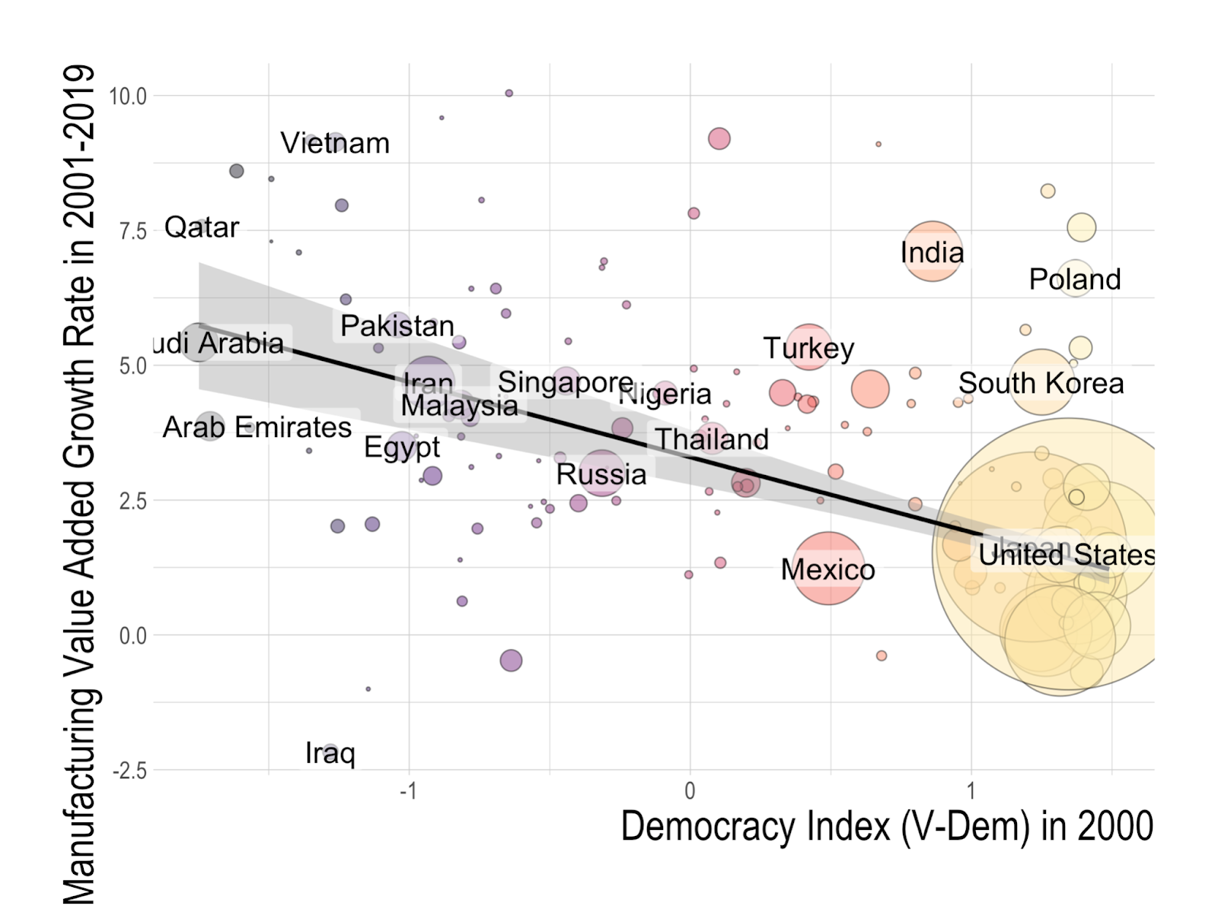

Slide 48
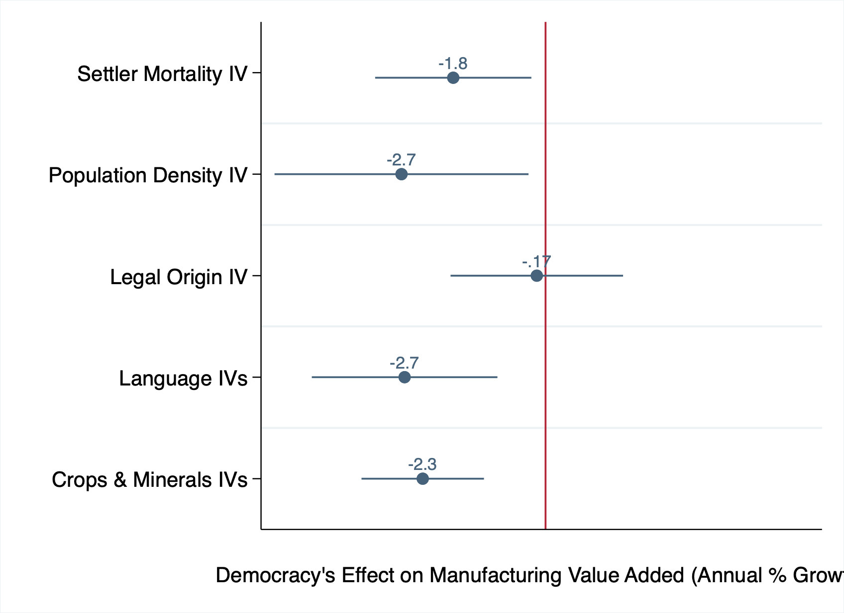
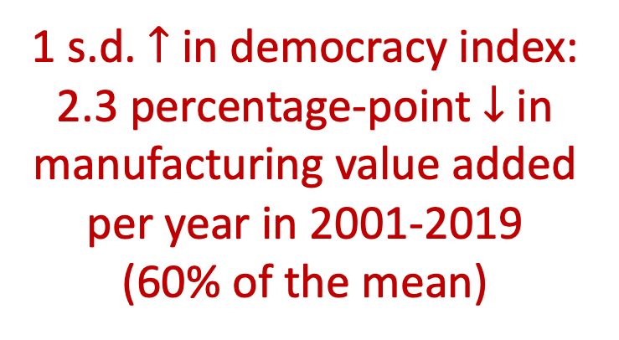
1 s.d. $↑$ in democracy index:
2.3 percentage-point $↓$ in manufacturing value added per year in 2001-2019
(60% of the mean)

Slide 49
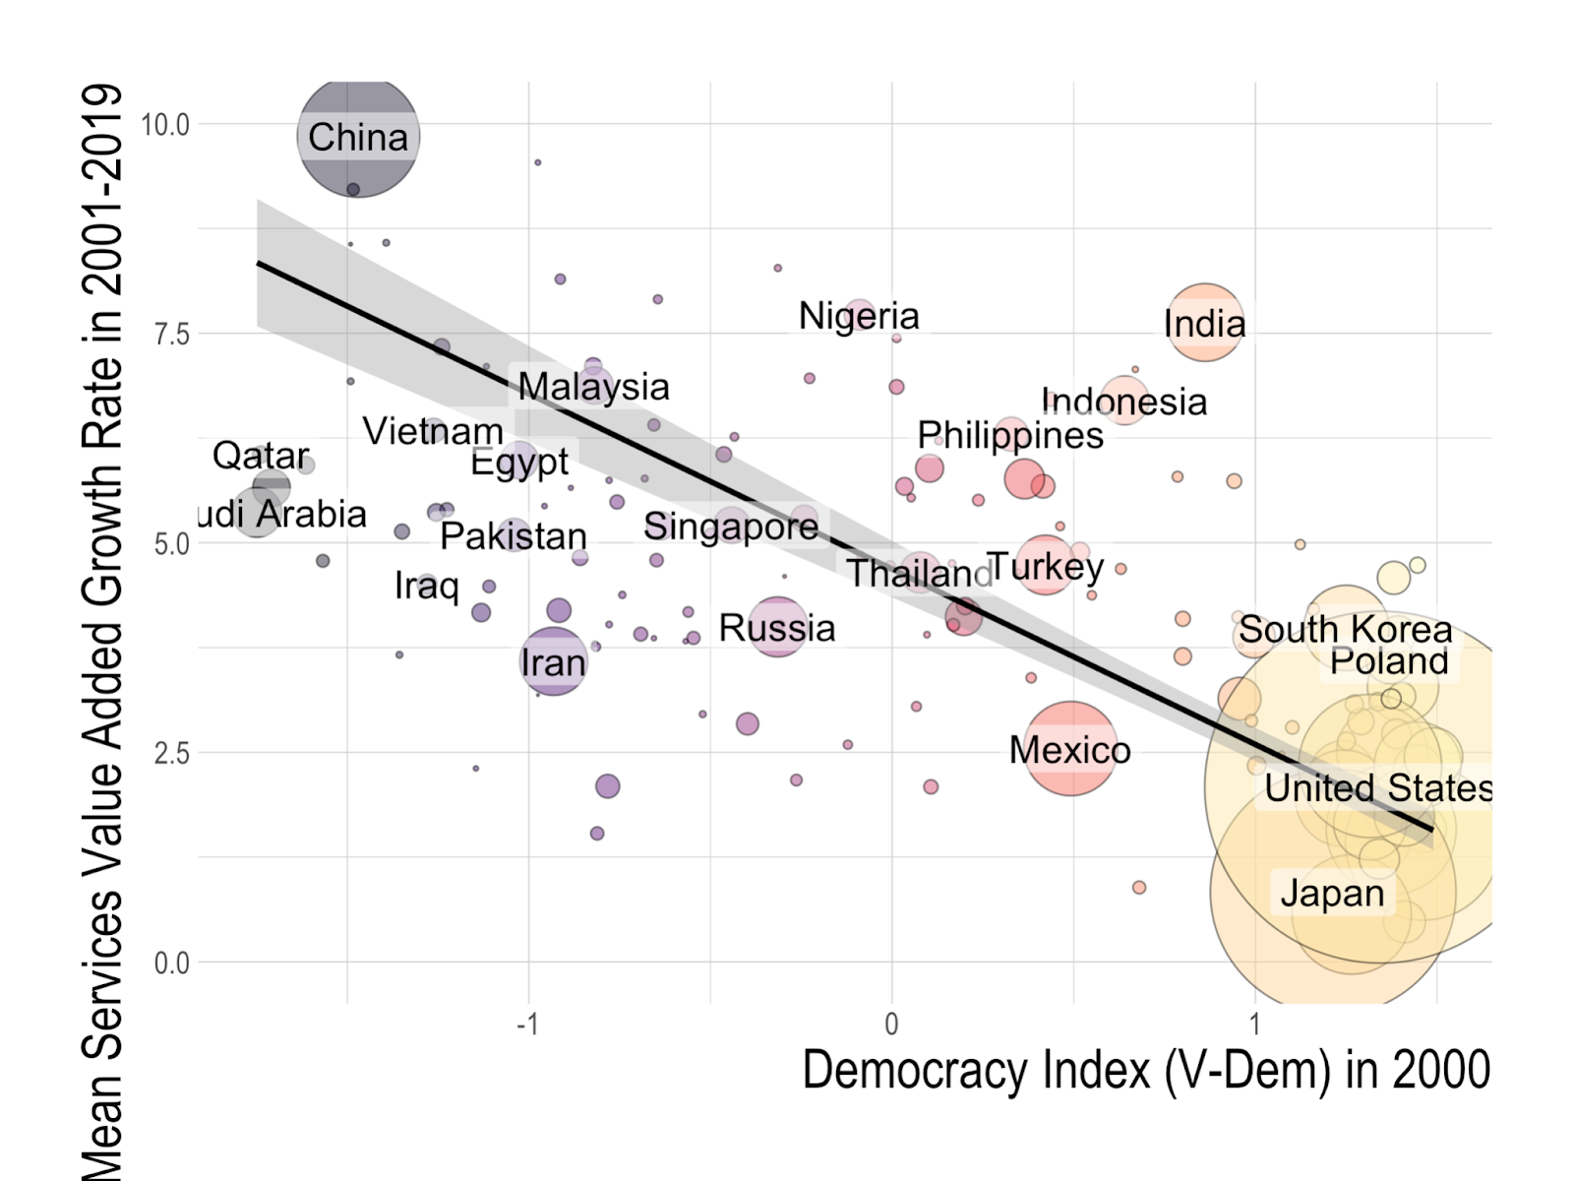

Slide 50
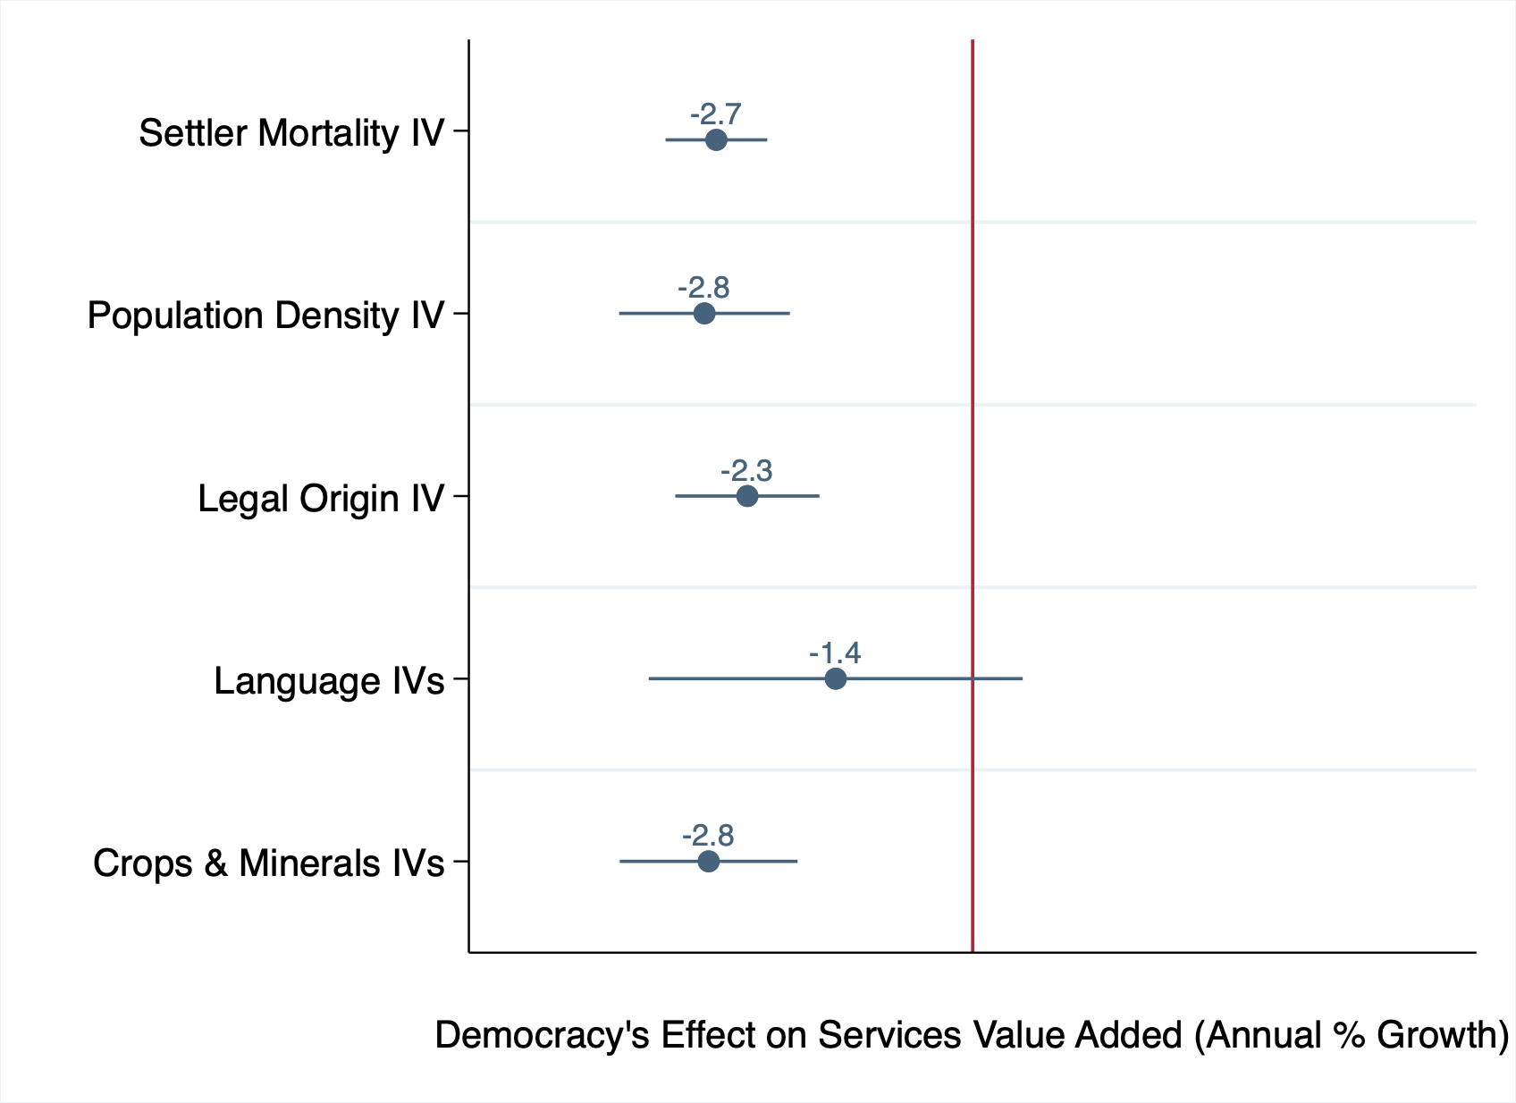
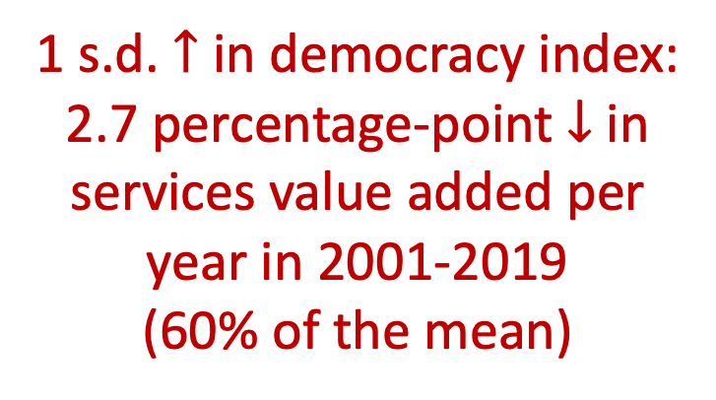
1 s.d. $↑$ in democracy index:
2.7 percentage-point $↓$ in services value added per year in 2001-2019
(60% of the mean)

Slide 51
Interpretation of Mechanisms
Democracy dampens economic growth through:
decreases in investment
decreases in trade
slower value-added growth
Notes:
In other words, non-democratic nations better foster investment, trade, and faster value-added growth

Slide 52
Outline
Data on economic and public health outcomes and democracy
OLS relationship between democracy and national outcomes
IVs for political regimes
Results
Democracy’s causal effect
Channels behind democracy’s effect in 2020
Conclusion

Slide 53
Curse of Democracy: Evidence from the 21st century
We found that:
Democracy has persistent negative impacts on GDP growth since the beginning of the 21st century
For 2020, democracy is also found to cause more Covid-19-related deaths
Mechanisms are likely to be decreases in investments and trade, and slower value-added growth

Slide 54
Curse of Democracy: Evidence from the 21st century
Moving forward:
Democracy’s effects on perfomance in other aspects (e.g. inequality, happiness)?
Geopolitical movements away from democracy?
Policy Implication:
Not a general case against democracy
normative and procedural virtues
democracies may be better in the long run
Preferred interpretation:
Democracy has room for improvement in particular aspects in particular situations.
Notes:
Our analysis leads to a variety of avenues for future work.
First, it is important to update the analysis with better outcome data. The data we currently use for GDP growth rates in 2020 are estimates by the IMF. We will update our analysis once official GDP growth rates are released.
Moreover, we recognize reporting policy may affect the reported number of Covid-19-caused deaths. One potential solution is to look at data on excess mortality rates, such as the World Mortality Dataset (Karlinsky and Kobak, 2021). But the dataset is still limited in coverage and currently only covers excess mortality rates for about 80 countries.
More conceptually, we plan to measure democracy’s effects on other key aspects of policy performance, such as economic inequality and citizen’s happiness.
Finally, we need to see if the negative impact of democracy will result in geopolitical movements away from democracy. We leave these challenging directions to future work.

Slide 55
Appendix

Slide 56
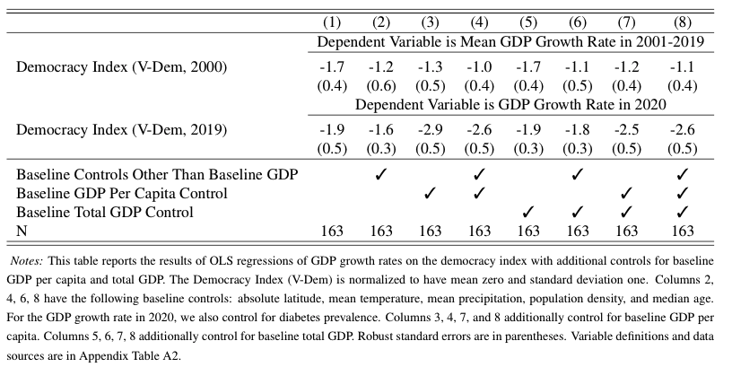
OLS with controls

Slide 57
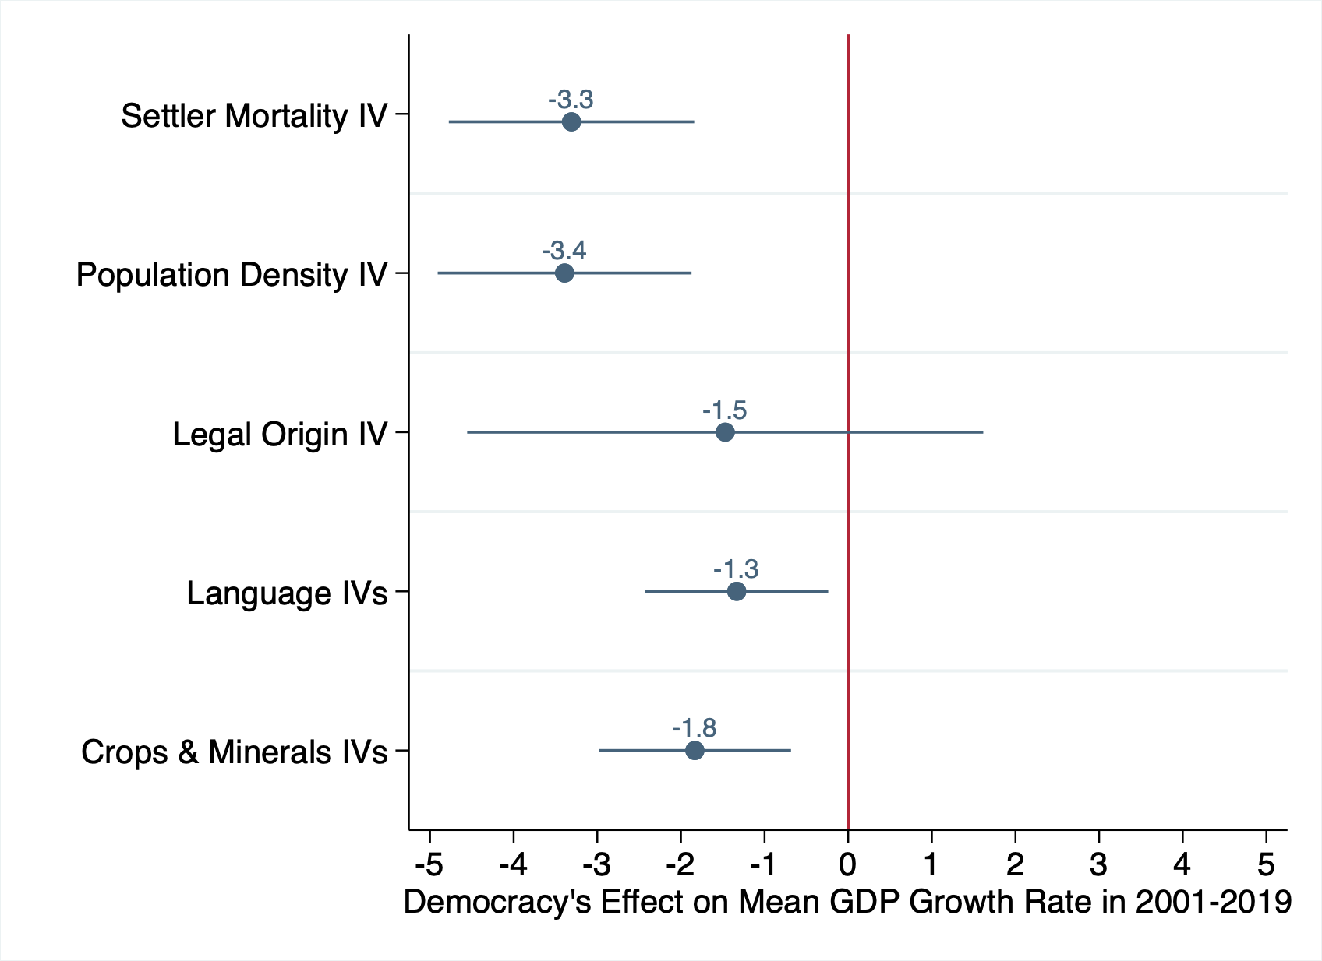
Add baseline controls

Slide 58
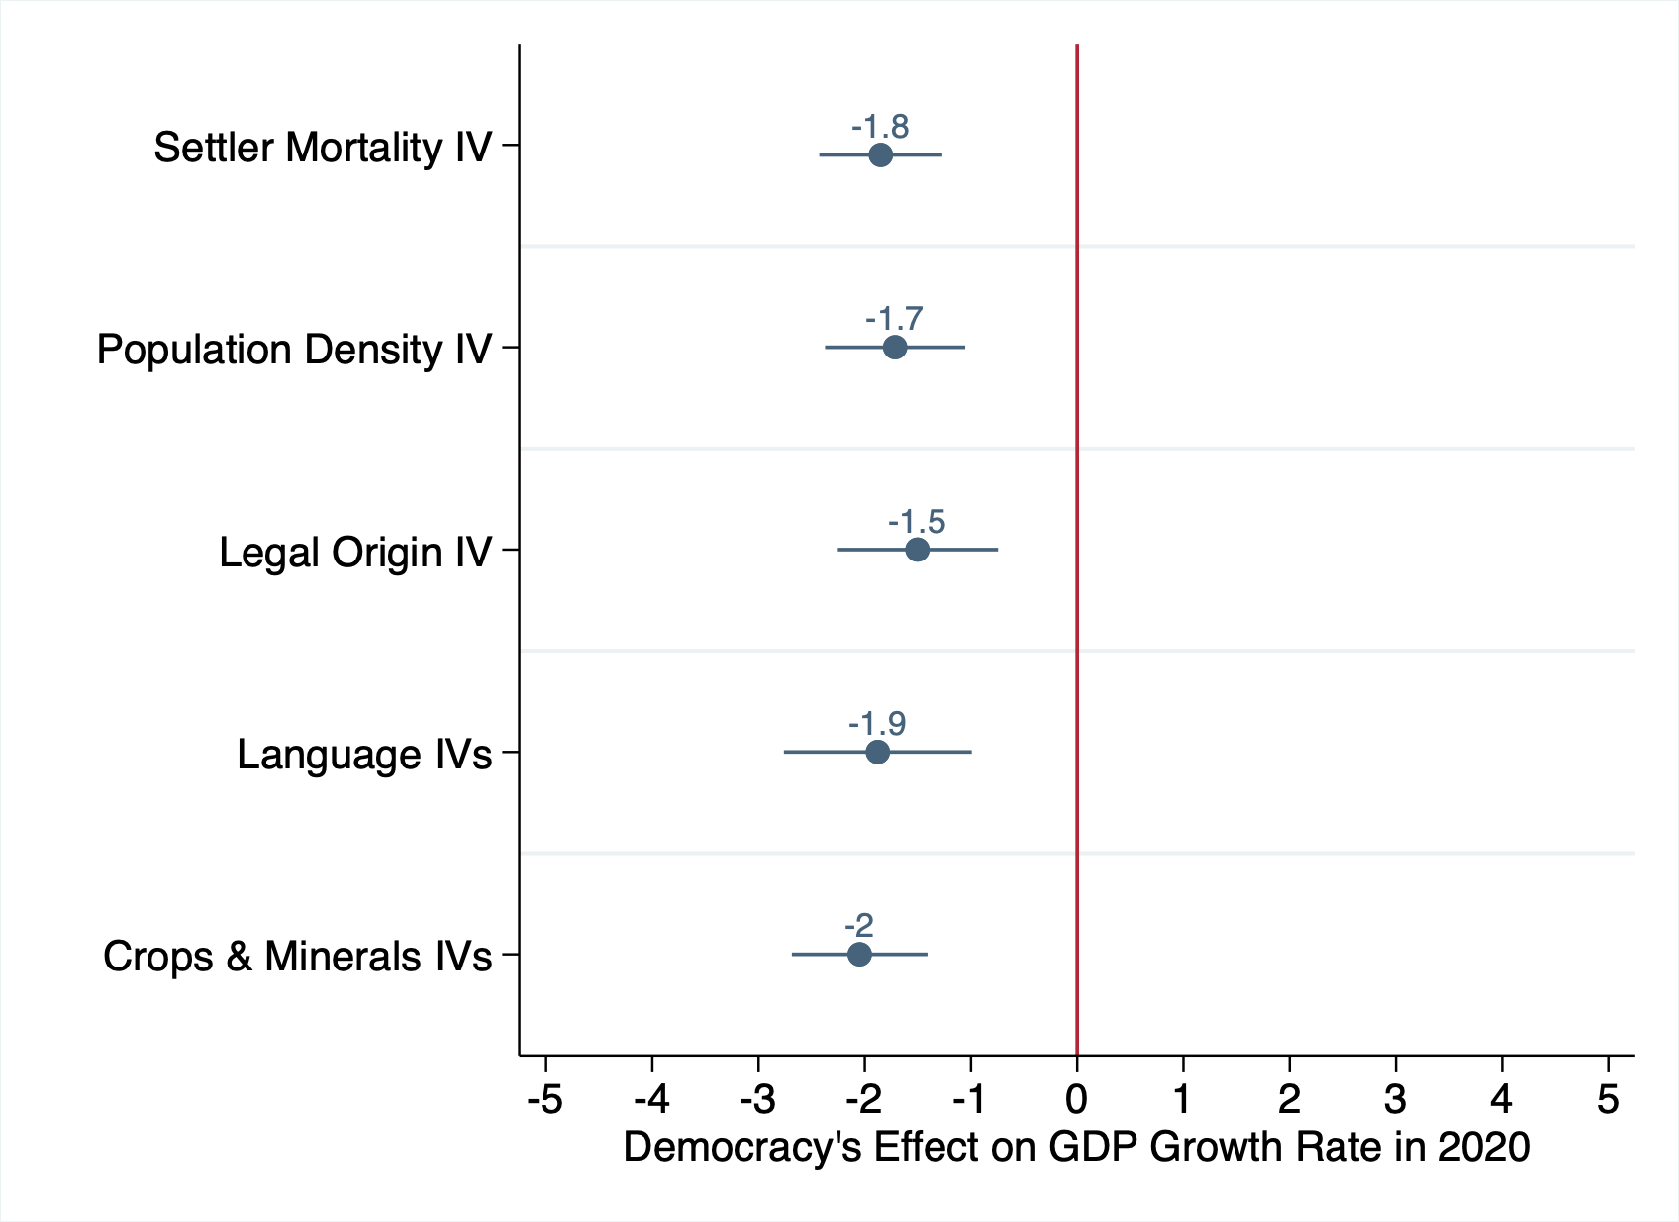
Add baseline controls

Slide 59
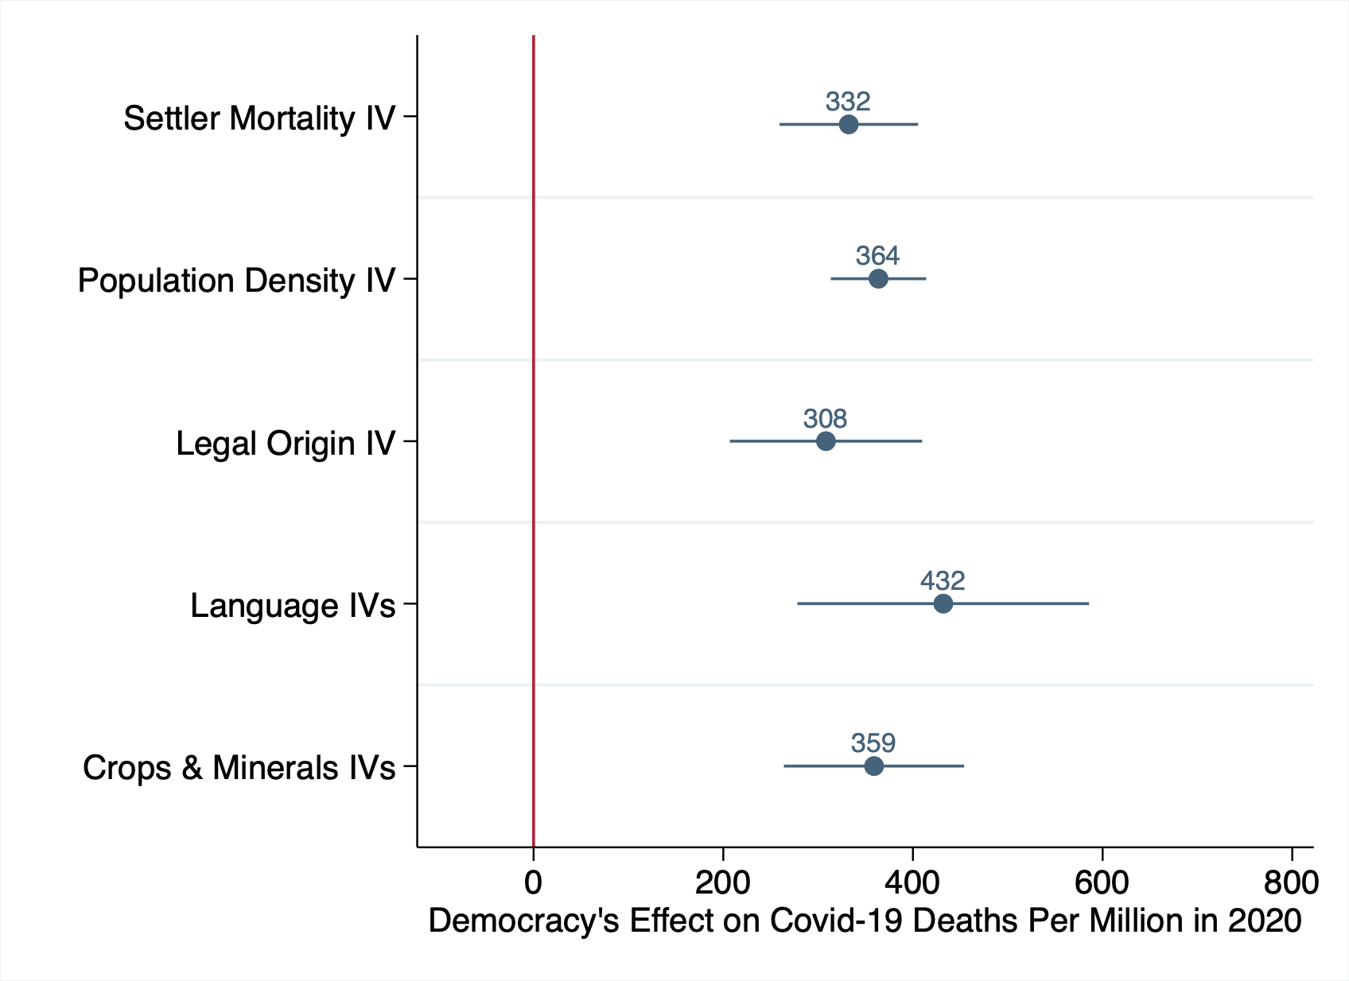
Add baseline controls

Slide 60
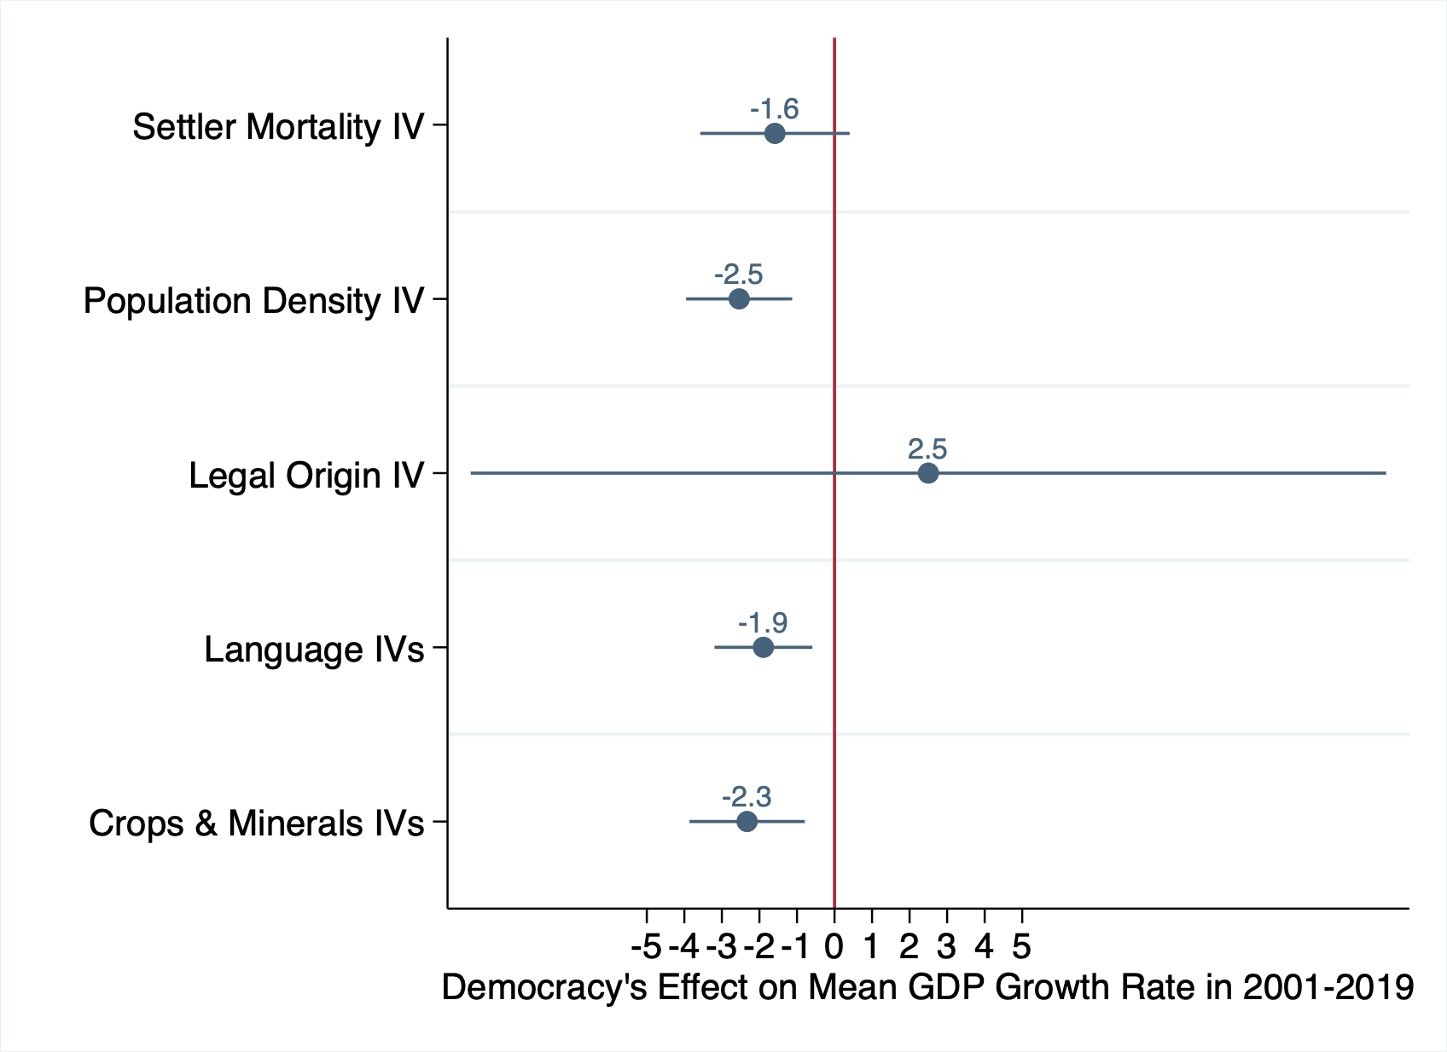
Add GDP per capita control
Notes:
no baseline controls

Slide 61
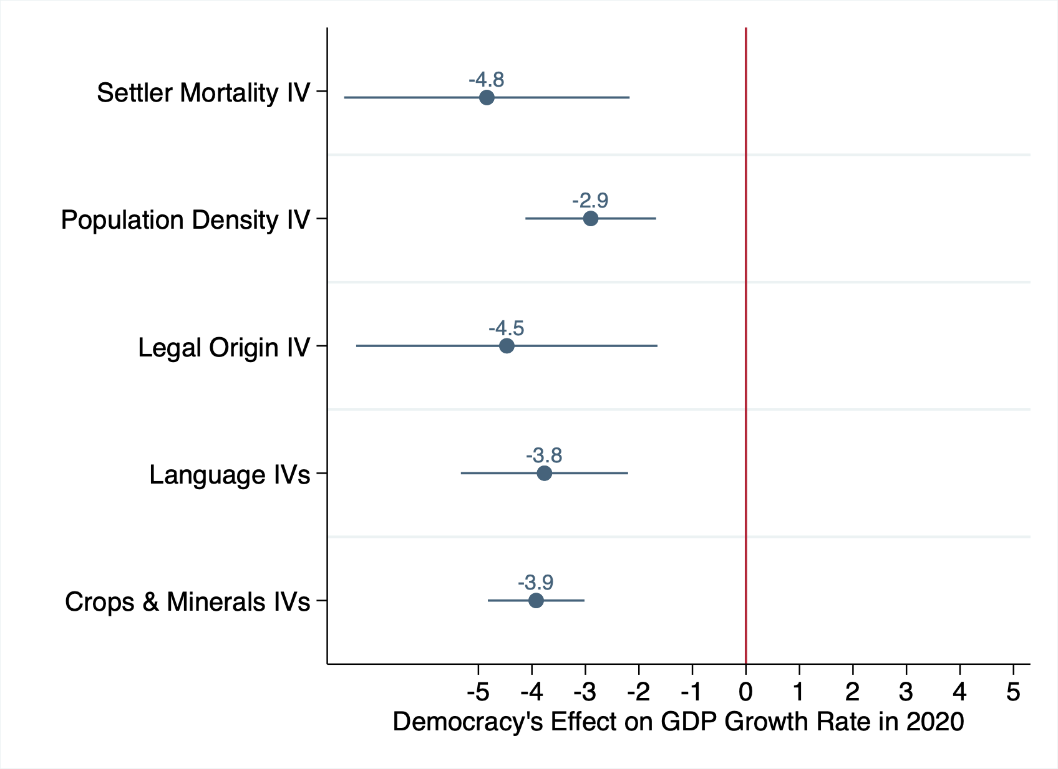
Add GDP per capita control
Notes:
no baseline controls

Slide 62
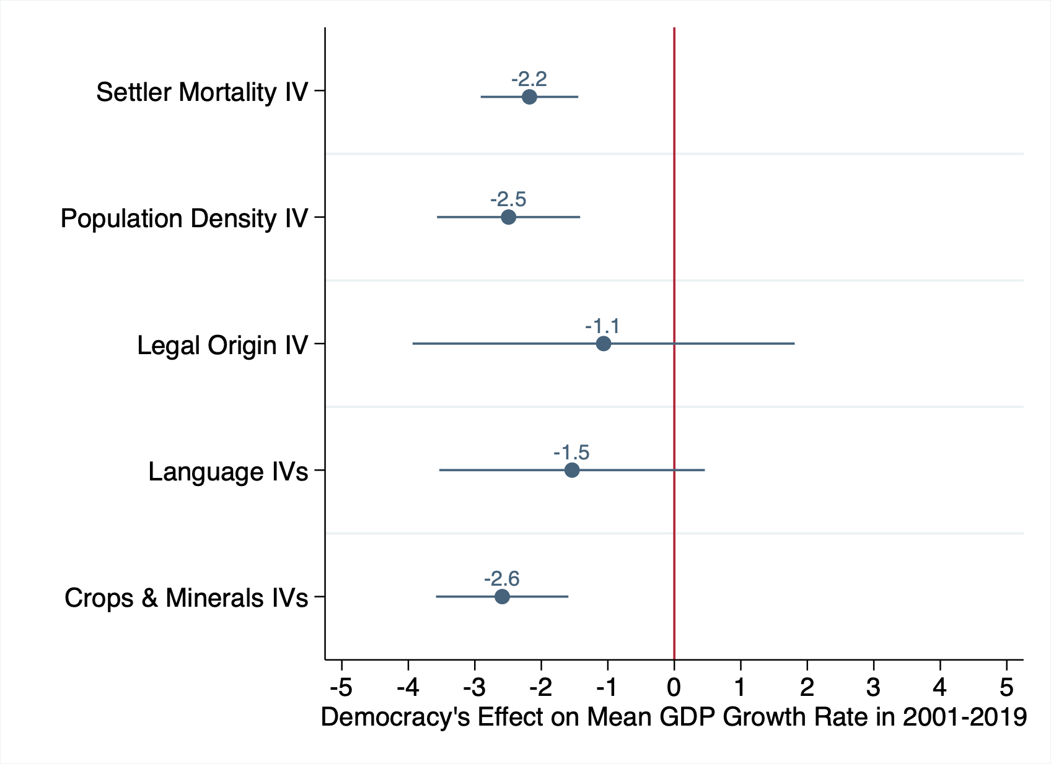
Add total GDP control

Slide 63
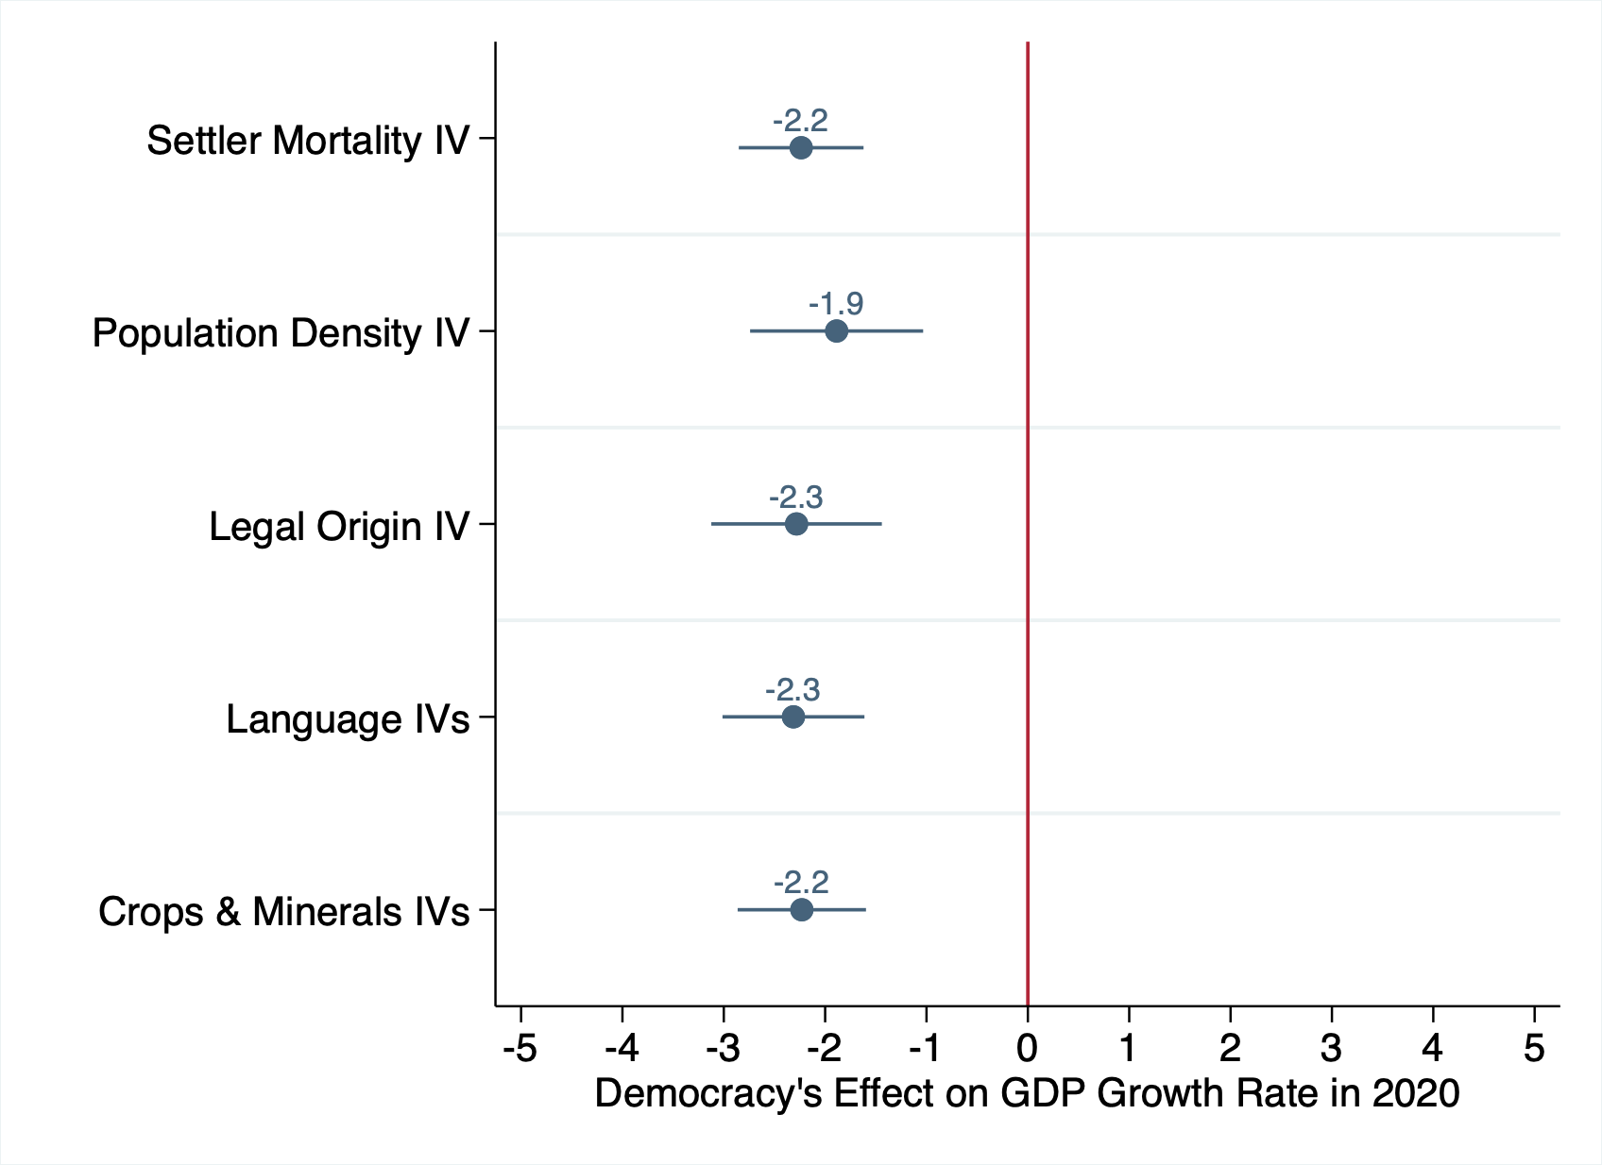
Add total GDP control

Slide 64
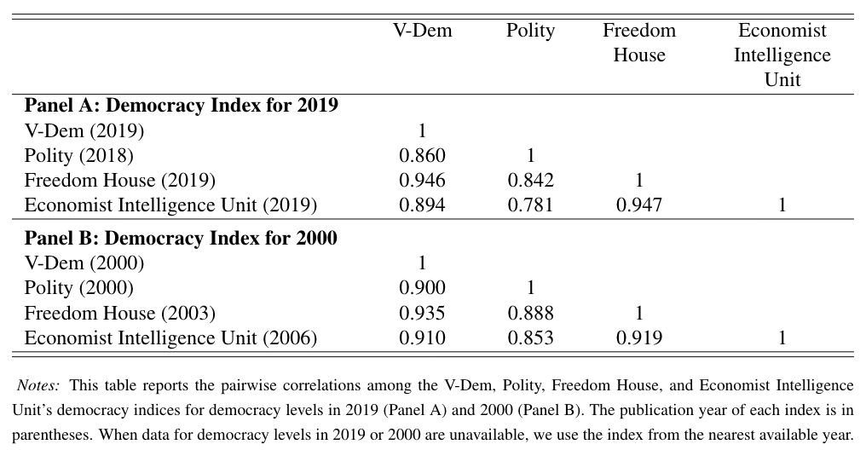
Correlation Between Democracy Indices

Slide 65
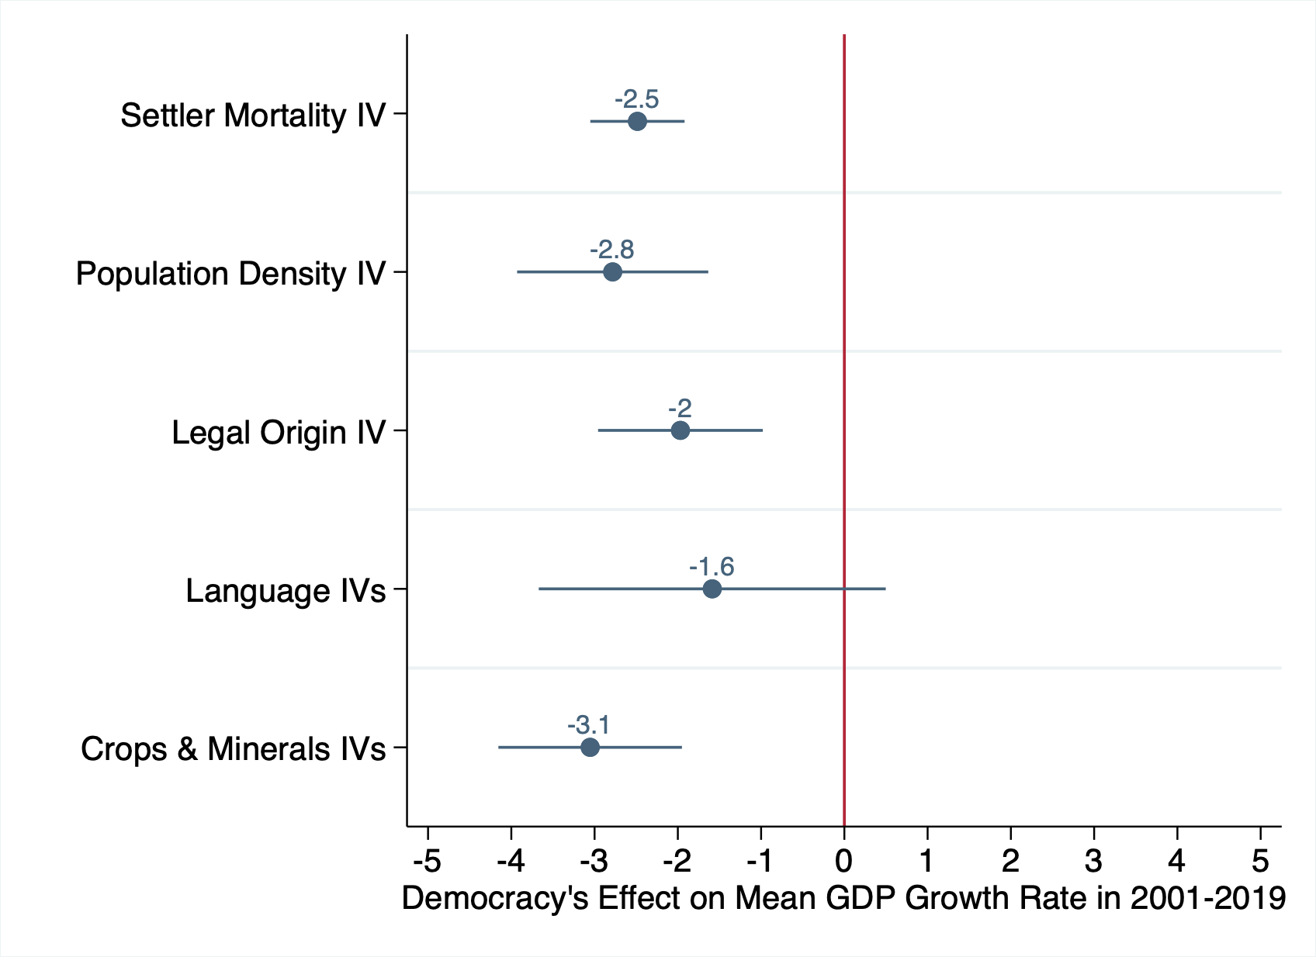
Polity Index (Center for Systemic Peace)
Notes:
no baseline controls

Slide 66
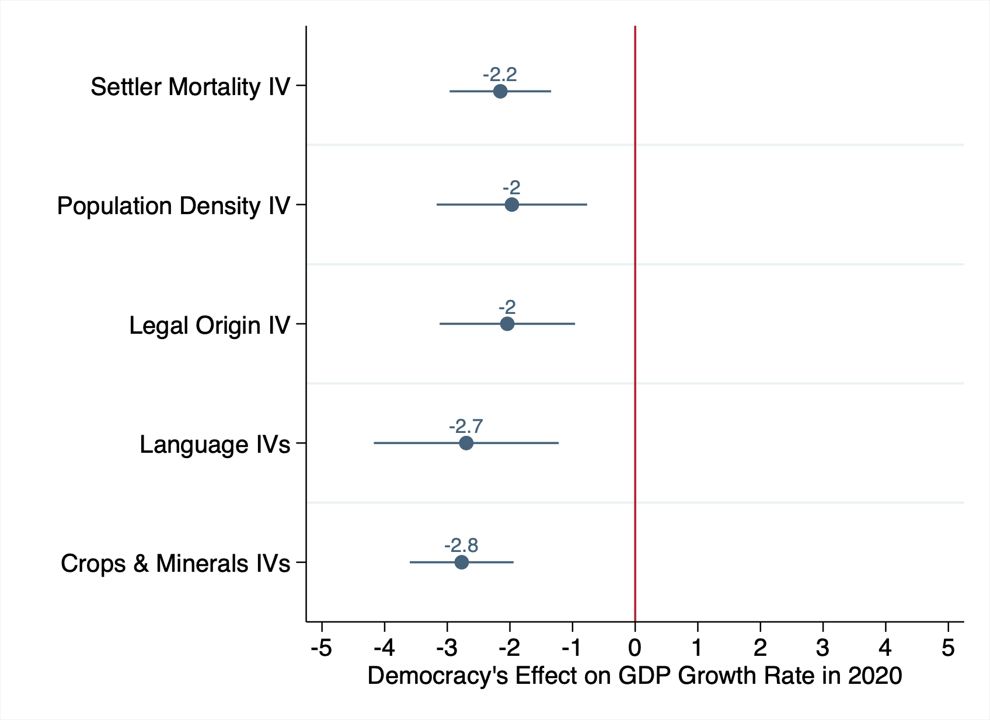
Polity Index (Center for Systemic Peace)
Notes:
no baseline controls

Slide 67
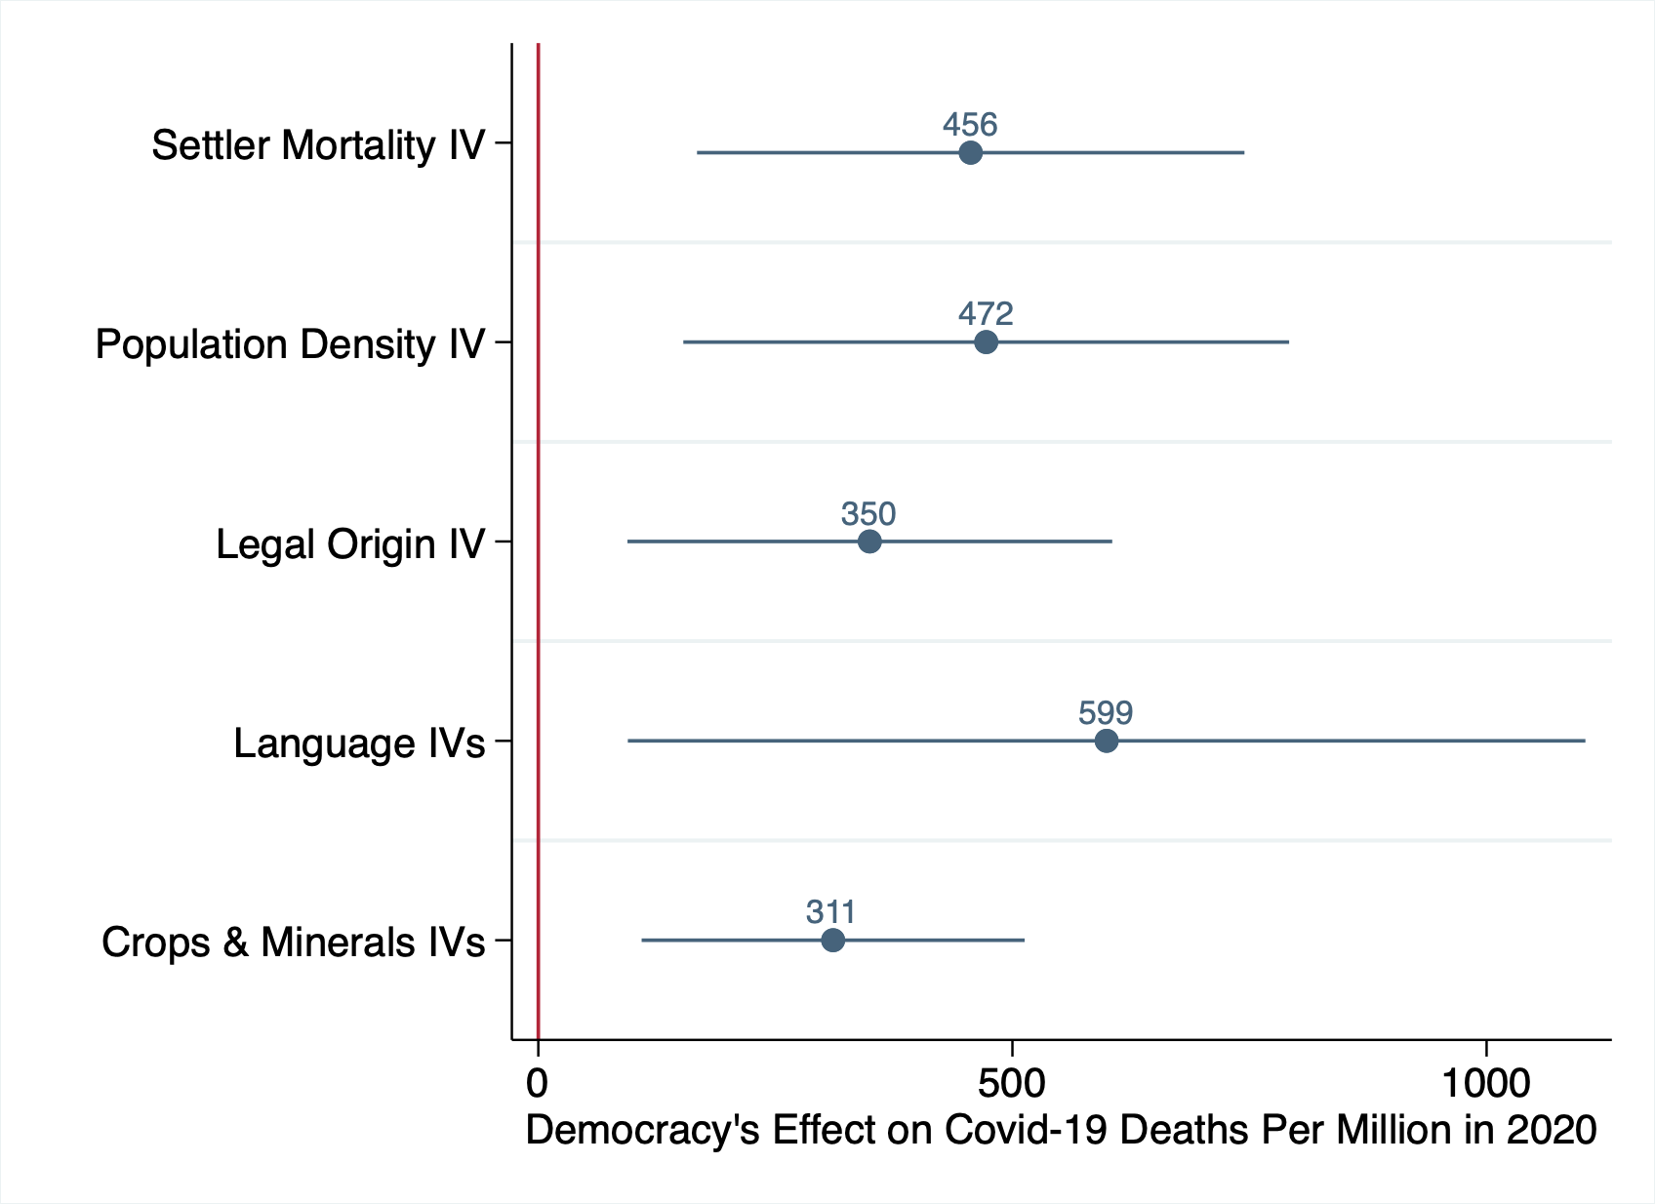
Polity Index (Center for Systemic Peace)
Notes:
no baseline controls

Slide 68

Freedom Index (Freedom House)
Notes:
no baseline controls

Slide 69

Freedom Index (Freedom House)
Notes:
no baseline controls

Slide 70

Freedom Index (Freedom House)
Notes:
no baseline controls

Slide 71

Democracy Index (Economist Intelligence Unit)

Slide 72

Democracy Index (Economist Intelligence Unit)

Slide 73

Democracy Index (Economist Intelligence Unit)

Slide 74

No weighting

Slide 75

No weighting

Slide 76

No weighting

Slide 77

Population weighting

Slide 78

Population weighting

Slide 79

Population weighting

Slide 80

Exclude G7

Slide 81

Exclude G7

Slide 82

Exclude G7

Slide 83

Exclude China and the US

Slide 84

Exclude China and the US

Slide 85

Exclude China and the US

Slide 86
Exclude countries with a standardized residual below -1.96 or above 1.96

Slide 87

Exclude countries with a standardized residual below -1.96 or above 1.96

Slide 88

Exclude countries with a standardized residual above 1.96 or below -1/96

Slide 89





